Slide 1
AP European History
Introduction and Background

Slide 2
Agenda: Day 1
Welcome
Meet your teacher (you already know me, I’m sure)
How this class will be for you: Hard
Themes of AP Euro
The AP Test overview
Syllabus
Book overview
Semester schedule overview
Websites overview
Questions?
Homework:
  Start Reading Chapter 11
  10 Questions from Europe After the Black Death

Slide 3
Themes of AP Euro
Interaction of Europe and the World
Poverty and Prosperity
Objective Knowledge and Subjective Visions
States and Other Institutions of Power
Individual and Society

Slide 4
The AP Test
55 minute/80 question M/C (1450-today) – 40%
  ½ to French Rev/Napoleon
  ½ after…(1/4 19th and ¼ 20th)
Short Answer: 50 Minutes – 20%
Free Response:
  55 minute DBQ – 25%
  35 Minute Free Response – 15%

Slide 5
Websites
My website: http://www.astorianpsych.info
  AP European History main page: https://astorianpsych.info/ap-european-history/
  AP Euro drop down menu at the top of the screen/right side of the page
    Includes review materials, art resources, document readings, and a test calendar (project due dates will be announced when projects are assigned)

Slide 6
Homework Assignment
Homework:
  Show your parents your syllabus
  Start reading chapter 11
  Come up with 10 questions for Wednesday’s class discussion
  Write down any questions you have over the readings in general
  Make sure you read History: A Short Introduction by Monday

Slide 7
Day 2: Setting the Stage—Late Medieval Europe
What were the historical origins of medieval Europe?
What were the diplomatic/international forms in medieval Europe?
What was the political system in medieval Europe?
What was the economic system in medieval Europe?
What was the role of the Church in medieval Europe?
What was the role/form of the state?
What were women’s roles?

Slide 8
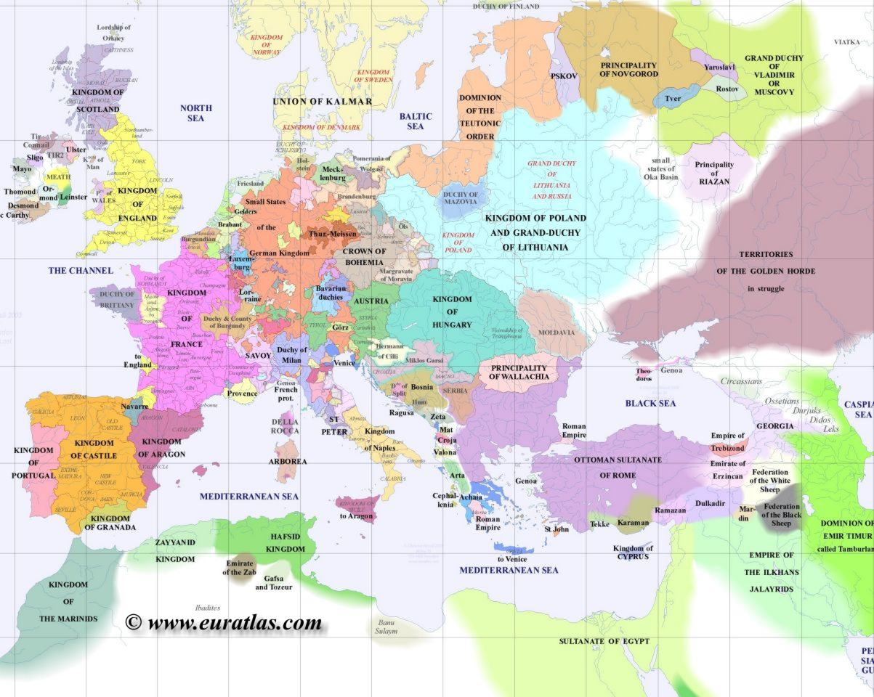

Slide 9
Late Medieval Europe: The West
Spain
  Reconquista
  Defeat of Grenada (1492)
  Merging of Castile and Aragon
France:
  English kings or Burgundian dukes dominate much of the land
  French kings gaining power through period
England
  Magna Carta (1215)
  Parliament
  Strengthening of monarchy vs. nobles
Germany
  Outside Roman Empire
  Ottonian German fragments
  Golden Bull of 1356=Electors
  Holy Roman Empire
  300+ states
  Emperors have little power
Italy
  Communes
  Combat German (north)/papal (south) domination
  Social strife
  Most end up despotic

Slide 10
The East
Lithuania and Poland
  Coalesce into powerful kingdoms
  Assemblies more important than royal south
Russia (Muscovy)
  Throws off Mongol rule (1243-1480) and begins to acquire huge sections of land
  Nobles retain much power
  Orthodox
Byzantine (Roman) Empire falling to Islamic forces
  Fall of Balkans to Muslim Ottomans
  1453: Fall of Constantinople
  Ottoman conquest of most SE Europe

Slide 11
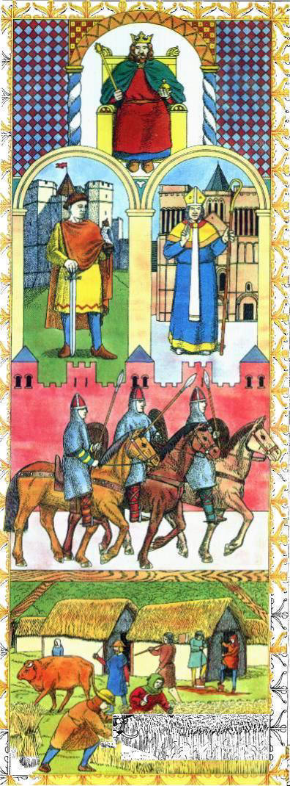
Feudalism
Medieval social structure

Slide 12
Feudalism
Basic Feudalism
Waning of feudalism in 14th
Developed as reaction to breakdown of law and order around 980-1030.
Overwhelmingly tied to agricultural economy.
Ideally:
  King to lord
  Lord to vassal
  Vassal to peasant
Never as tidy as presented…
Rule: As central ruler strength increases, feudalism decreases
  Most evident in West (France, England)
Money economy diminishes feudal relations
Black Death destroys these connections

Slide 13

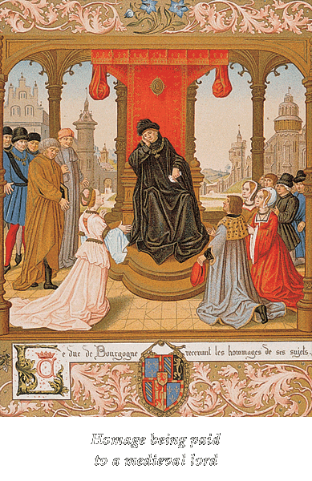








Slide 14
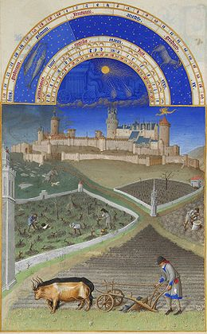
Manorialism
Medieval economic system – the manor was the center of the economic universe
Derived from late Roman society when trust in gov’t/cities was lost

Slide 15
Late medieval economics
Agricultural economy
  Serfdom and free peasantry (Can tax peasants)
  Urban/town growth encourages cash-crop farming
    Down with serfdom
  Three-field system=Increased yields, decline of smaller farms
  As peasants are freed=increased production and yields
Growth of urban areas/skilled workers
  Guilds
Increased trade and manufacturing
  Money economy
  Increased credit and banking; importance?

Slide 16
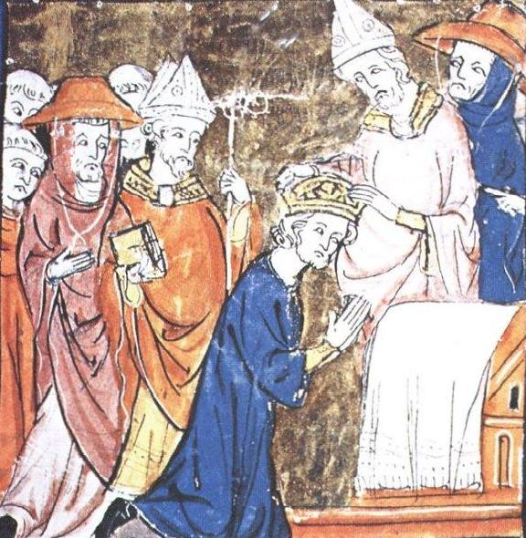
The Church

Slide 17
The Late Medieval Roman Church
Central theme: Secular or Papal rule?
Separate legal system for clerics
Monasteries, bishops acquire land, wealth
Expansion of legal and financial systems
  College of Cardinals emerges as a “senate”
  Legal and financial machinery collect revenues and adjudicate controversies
Disciplinary mechanisms:
  Excommunication
    Individual excluded from the sacraments
  Interdict
    Denial of sacraments to a region
  Inquisition
    Formal judicial procedure to correct heresy

Slide 18
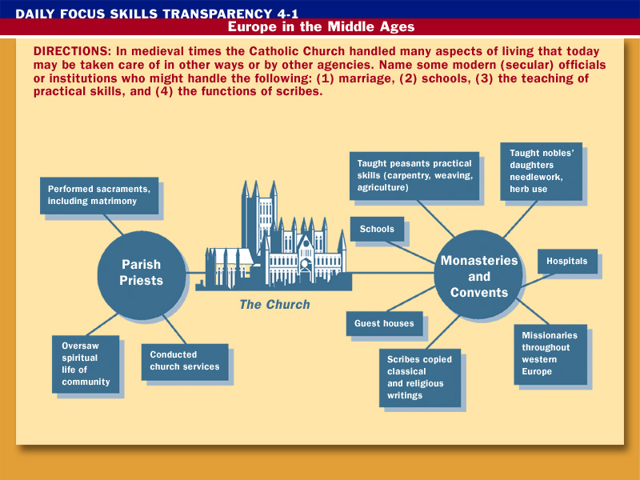

Slide 19
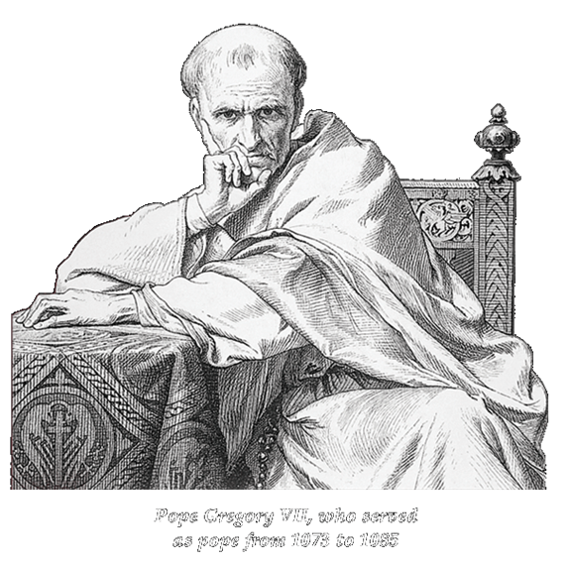

Slide 20
Broad Trends
Single great political/military event: Hundred Years’ War
Greatest social calamity: The Black Death (1347-1350)
Disastrous period for Church
  Babylonian Captivity (Avignon Papacy—1309-1377)
  Great Schism (multiple Popes—1378-1417)
  Anticlericalism and beginnings of calls for reform
    Wycliffe & Lollards in England
    Hus & Hussites in Bohemia

Slide 21
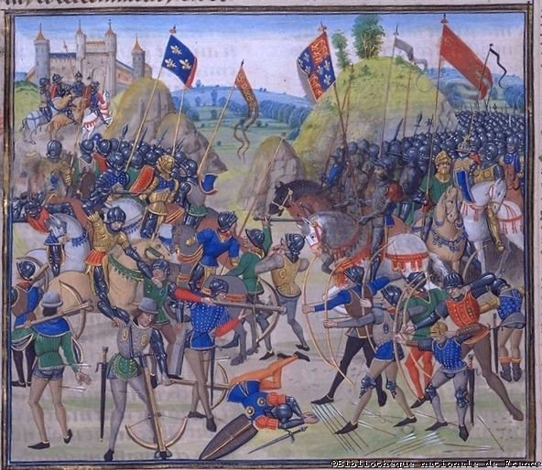

Slide 22
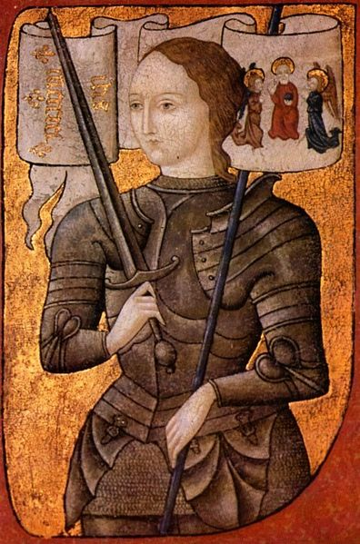
Joan d’Arc
16 year old leader of French army in later stages of the Hundred Years War
Claimed to hear voices of saints/others claimed her to be mentally ill
Burned at stake for witchcraft
Not Noah’s wife

Slide 23
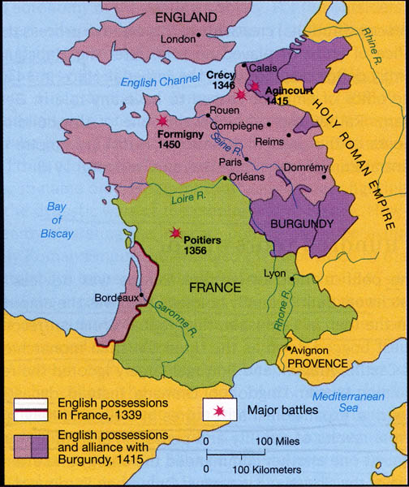
France in the Hundred Years’ War: 1340-1456

Slide 24
Hundred Years’ War (1340-1453)
Three major causes: Control of Gascony, the Flemish cloth trade, contentions about the French succession
  Philip VI’s claim to the French throne was challenged by King Edward III
  Chivalry encouraged warfare; martial honor required an escalation of violence
Philip VI had little control over his nobililty and had to rely on extortion of foreign merchants and bankers for funds; this and the disruption of trade crippled the French economy
England was therefore able to afford a more modern army equipped with longbows and pikes

Slide 25
Hundred Years’ War (1340-1453)
Edward III claims throne of France (1340)
Only three major campaigns—English win all great battles and hold much of France (Crecy – 1346; Poitiers – 1356; Agincourt – 1415)
Joan of Arc & Seige of Orleans - 1429
End: After defeat at Formingy (1450), England only holds Calais
Results for France:
  Heightened sense of national consciousness
  Professionalized military
  Generalized taxation (Estates General)
  Restored royal prestige
Results for England:
  Unified the concept of “England”
  Enhances role of Parliament (“redress before supply”)
  Creates frictions among nobility the lead to War of Roses

Slide 26
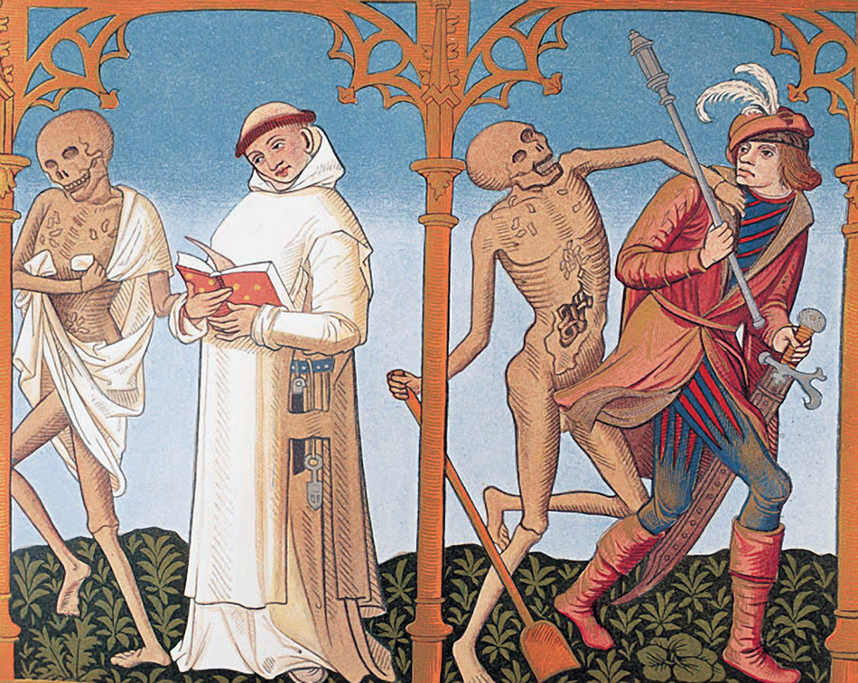

Slide 27
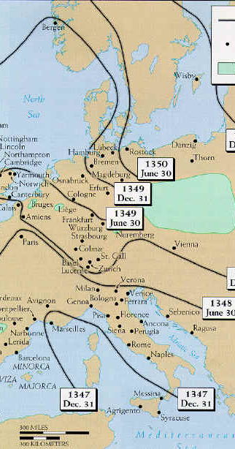
Spread of the Black Death

Slide 28
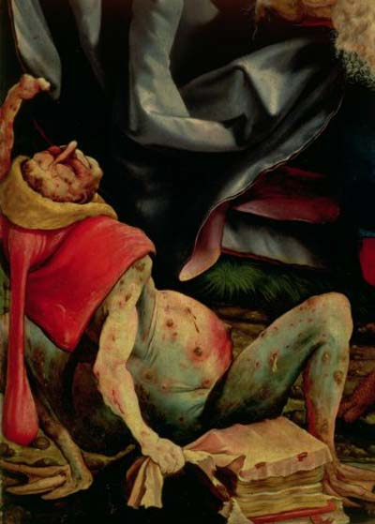
The Black Death: 1347-1351
Famine: 1315-1317
Spreads from central Asia (Caffa)
Arrives in Sicily in 1347
Cause?
Bubonic (black hemorrhaging), Pneumonic (coughing), Septicemic (blood-born) forms
By 1350, up to 1/3 of all Europeans die
Social and Political Changes:
  Destroys feudalism. How?
  Weakens Church. Why?
  Restructures European political, social, and economic order. How?
  Alters European psyche. How?

Slide 29
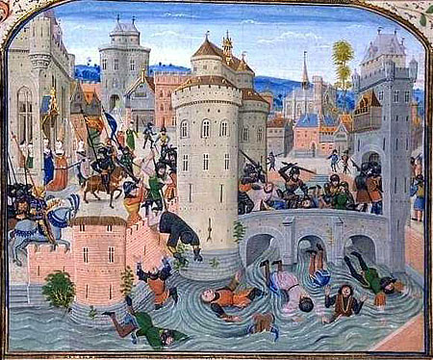

Slide 30
Peasant revolts
Jacquerie (1358)
  French nobility attempts to bring back feudalism
  Taille (taxes) increased
  Brutally suppressed
  Traumatizes already discouraged aristocracy
Peasant Revolt of 1381
  English nobility also attempts to restrict peasant movement
  Richard II and Wat Tyler

Slide 31
Crises in the Church:
Background
Struggle between Church and secular leaders
  Investiture controversy of 11th-13th centuries
  Taxation becomes the major issue
Boniface VIII and Philip the Fair of France
  Clericis laicos (1296)
    Forbade lay taxation of clergy
  Unam Sanctam (1302)
    Issued by Boniface VIII
    Claimed that belonging to the Church was necessary for salvation, the pope was the supreme head of the Church, and therefore submission to the pope was necessary for salvation
    Temporal authority subject to the Church – MASSIVE over-reach
  Philip defeats Boniface (1303) via embargo banning export of gold, silver, precious stones, and food from France to the Papal States
  Power tilts in favor of state

Slide 32
Crises in the Church:
“The Babylonian Captivity” (1309-1377)
Clement V—French—elected Pope
  Papal Court moved to Avignon (1307)
  French dominate College of Cardinals
Legislation restricting papal jurisdiction and taxation (late 14th century)
  France, England, Germany
Pragmatic Sanction of Bourges (1438)
  French appointments of clergy
  Prohibition of annates
  Limited right of appeals in Curia

Slide 33
Crises in the Church:
The Great Schism (1378-1417)
Church returns to Rome in 1377
Urban VI (r. 1378-1389) elected in Rome
  Determined to reform Curia; problems?
King Charles V, French recall papacy to Avignon
  Clement VII named as pope (anti-pope) (1378)
(Alexander V elected as a third pope!)
What problems arise?

Slide 34
Conciliar Movement
Conciliar theory
Council of Pisa (1409-1410)
  Alexander V elected
  Other two popes refuse to step down
Council of Constance (1414-1417)
  Council declares its supremacy
  Great Schism ended
Council of Basel (1431-1449)
  Four Articles of Prague
Popes eventually win
Significance?
  Europeans see the role of leaders as being for the people, not for the leaders
  Religious responsibility devolved to laity and secular governments
  Papacy loses much control in England, France, Bohemia, becomes focused on Italian issues

Slide 35
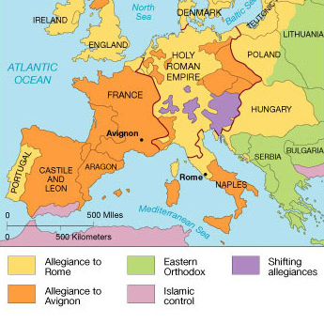
Varying Allegiances
Why were the respective areas loyal to the respective Popes?

Slide 36
Lay Opposition to the Church
Marsilius of Padua (1290-1342)
  Defender of the Peace (1324)
  Supremacy of secular power in temporal matters
John Wycliffe (d. 1384)
  Bible is sole authority
  Supports clerical poverty and secular power
  Merit only basis of religious authority
  Lollards in England
    Preach in vernacular
    Translations of Scripture
    Later deemed subversive
John Hus (d.1415)
  Hussites (Bohemia)
    Support vernacular translations
    Critical of ceremony and superstition
    Lay communion with cup and bread
    Sacraments based on goodness of priest
    Huss burned at stake
    Hussites eventually win much local control
In what ways were these movements predecessors of the Reformation?

