Slide 1
The Reformations
The Protestant and Catholic Reformations, 1517-1555

Slide 2
Reformation? Reformations?
Protestant reformation a watershed in Western civilization
Many religious movements in 16th century = reformation (Re-formation (make over), or Reformation (make better)?)
  Orthodox, Jews, Muslims = Hard to see problem
  Protestants differ as sharply among selves as with Rome
  Reformers initially do not see selves as anti-Catholic

Slide 3
Popular Religious Movements and Criticism of the Church
Reformation could not have happened without the earlier challenges to the Church’s authority:
  Avignon papacy
  The Great Schism
  The Conciliar Period
  The Renaissance papacy
Lay criticism of the church was growing
  Many sought a more egalitarian church

Slide 4
Lay Control Over Religious Life
The benefice system, the sale of religious office to the highest bidder, was collapsing.
Communities were loudly protesting financial and spiritual abuses, such as the sale of indulgences.
City governments were endowing preacherships.
Magistrates were restricting the growth of ecclesiastical properties and clerical privileges.

Slide 5
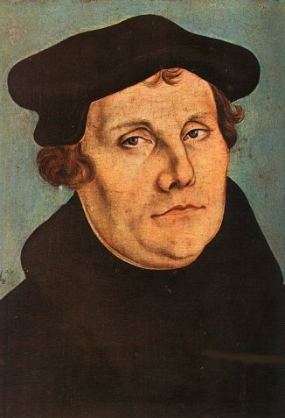
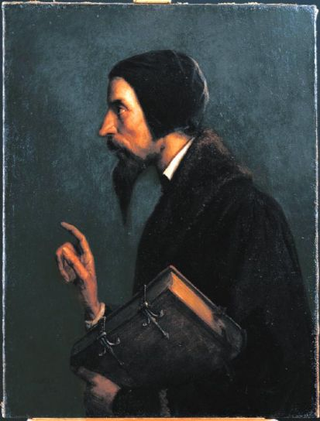
“Magisterial Reformers”:
Luther and Calvin
Magisterial = “Master”, “Teacher”
Martin Luther (1483-1546)
John Calvin (1509-1564)

Slide 6
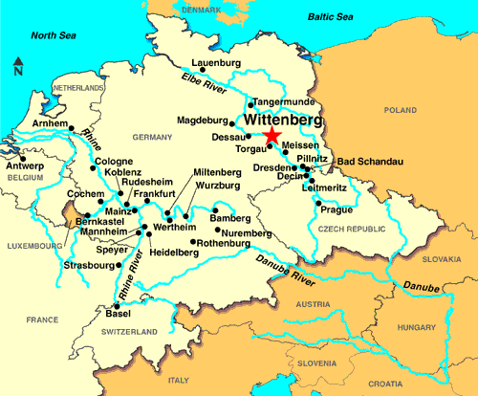
Martin Luther (1483-1546)
Born in small, N German town to miner family
Local education & University of Erfurt
Plans to go into law, does not
Augustinian monk
Visits Rome, confirms suspicions
Begins teaching at University of Wittenberg

Slide 7
Luther’s Path to Reform
Influenced by Christian humanism and contemporary criticism of the church
Highly sensitive personality
  Prone to deep doubts and pessimism
  Could not convince himself that he was worthy of God, not that actions on his part could benefit
“Justification by Faith”
  Concluded God does not demand charitable acts and religious ceremonies, but just faith in Jesus Christ as perfect righteousness. Good works expected, but did not earn one salvation.

Slide 8
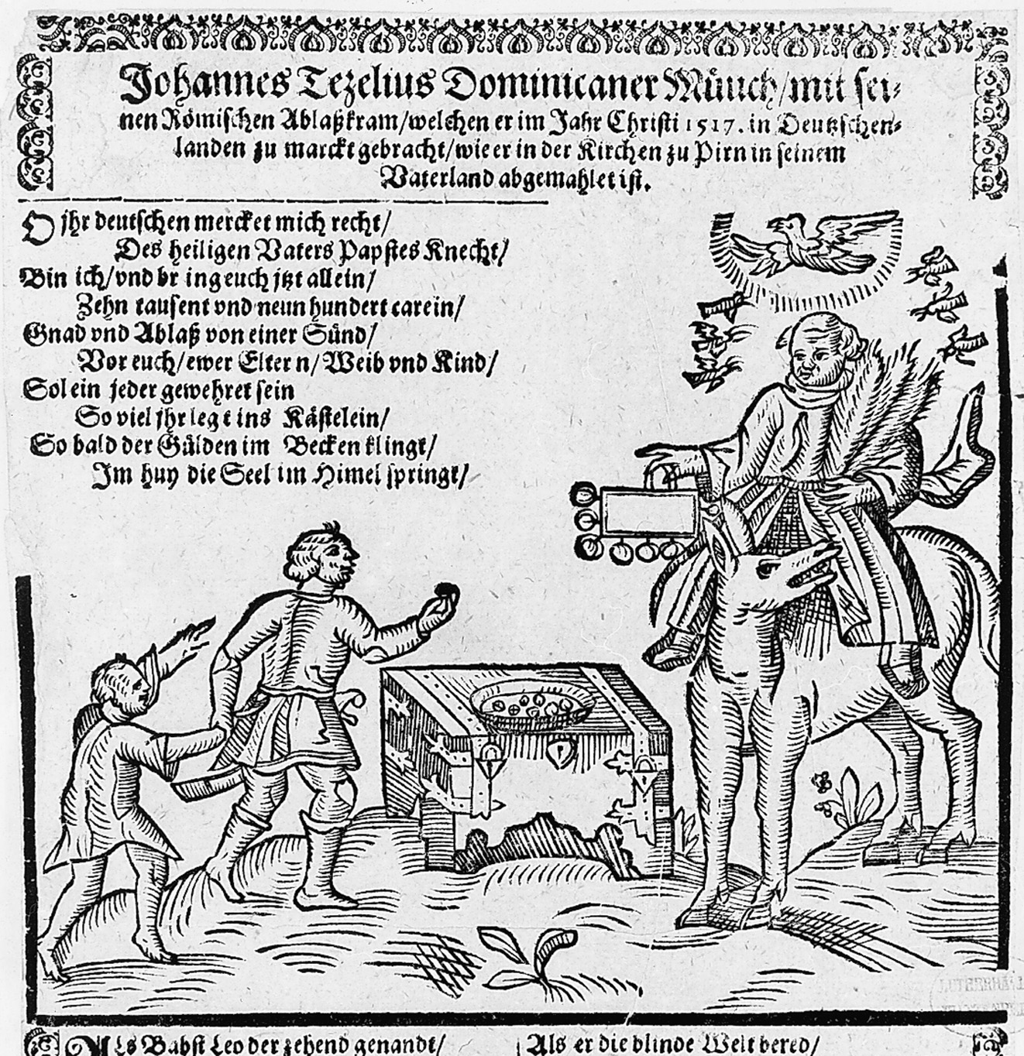
Caricature of Johannes Tetzel
“So bald der Gulden im Becken klingt/Im huy die Seel im Himel springt.”
(“As soon as gold in the basin rings, right then the soul to Heaven springs.”)
Notes:
A contemporary caricature depicts John Tetzel, the famous indulgence preacher. The last lines of the jingle read, “As soon as gold in the basin rings, right then the soul to Heaven springs.” It was Tetzel’s preaching that spurred Luther to publish his ninety-five theses.
Courtesy Stiftung Luthergedenkstaten in Sachsen-Anhalt/Lutherhalle, Wittenberg

Slide 9
Indulgences
Remission of temporal punishment in purgatory
Indulgence fairly typical aspect of medieval Catholicism = Became bloated
Johannes Tetzel (1516), master indulgence salesman
  Selling indulgences on behalf of Jubilee, rebuilding of St. Peter’s
Luther has two problems with indulgences:
  Smacks of “good works”
  Transfers German money through Austrian bankers to Rome
Ninety-five Theses (31 October 1517)
  NOT initially intended as a defiant act
  Church tries to discipline through the order
  Humanists rally

Slide 10
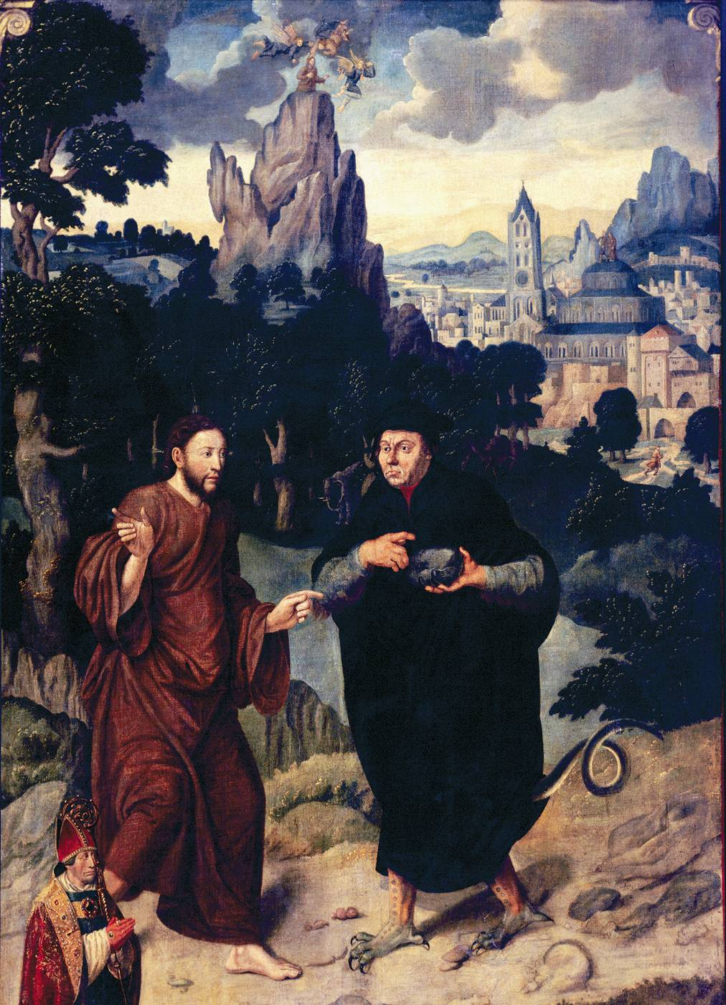
Martin Luther as Satan tempting Christ (1547)
Luther is requesting Christ turn a stone into bread; Jesus responds that “man does not live by bread alone.”
What is the intent/message of this painting?
Notes:
A Catholic Portrayal of Martin Luther Tempting Christ (1547). Reformation propaganda often portrayed the pope as the Antichrist or the devil. Here Catholic propaganda turns the tables on the Protestant reformers by portraying a figure of Martin Luther as the devil (note the monstrous feet and tail under his academic robes). Recreating the biblical scene of Christ being tempted by the devil in the wilderness, the figure of Luther asks Christ to transform stone into bread, to which temptation Christ responds by saying that humans do not live by bread alone.
Versucung Christi, 1547, Gemälde, Bonn, Rheinisches Landesmuseum, Inv. Nr. 58.3

Slide 11
Break from Rome
Debate with Johannes Eck (July 4th – 27th, 1519): Luther rejects papal authority and councils = De facto separation from Rome
Three great treatises (1520): Printing press?
  Luther the first mass propagandist
  Address to the German Nobility
    German rulers to reform church, ban celibacy, masses for dead, religious orders
    “German money…is flying over the Alps"
  On the Babylonian Captivity of the Church
    Abolish denial of communion in both kinds
    Only baptism and Eucharist valid sacraments
  On the Freedom of the Christian Man
    Salvation depends on faith & grace
    No need to do good works
  “The pope should stand up like the stinking sinner he is!”

Slide 12
Rome strikes back & Luther’s response
Rome condemns 41 theses (1520), then Leo X excommunicates Luther (1521)
Leo X calls Luther before Diet of Worms; problem?
Diet of Worms (1521)
  “Long live Luther!” “Death to the Pope!”
  Luther refuses to recant
  Charles V presides (“Bist du allein Klug?”- “Are you the only King?”)
  Imperial ban = Outlaw
  Safe conduct honored, returns to Saxony
  Elector Frederick III protects Luther; why? He’s sympathetic!
Colloquy of Marburg (1529): Negotiations, but no agreement with Rome—Disagreement with Zwingli
Luther marries (1524): Former nun, Katerina von Bora
Luther translates Bible into German
  Lesser & Greater Catechisms
  Treatises, Biblical commentaries, Hymns (“A Mighty Fortress is our God”)

Slide 13
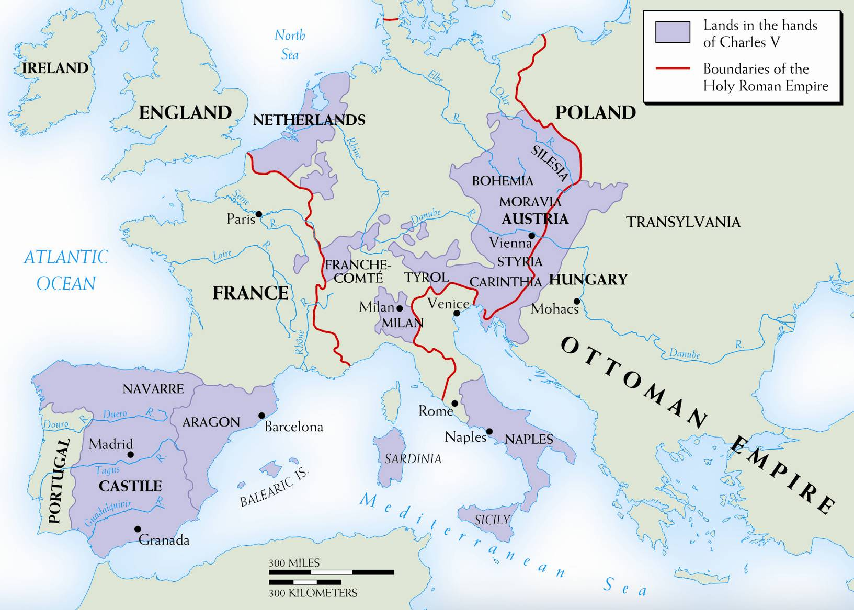
Notes:
Map 11–1 THE EMPIRE OF CHARLES I Dynastic marriages and simple chance concentrated into Charles’s hands rule over the lands shown here, plus Spain’s overseas possessions. Crowns and titles rained down on him; his election in 1519 as emperor gave him new distractions and responsibilities.

Slide 14
Spread of the Reformation
  Emperor distracted by wars with French and Turks.
    Permitted each local prince to enforce ban as he saw fit, giving each religious authority in own domain.
  In many cities, princes enact religious reforms, welcomed Lutheran preachers.
    The Elector of Saxony and the prince of Hesse both instated Protestantism in their lands.
    By the 1530s German Protestant lands formed the Schmaldkaldic League and prepared for war with the emperor.

Slide 15
Protestantism develops
Luther’s “Three Alones”: Sets standards for all Protestantism
  By faith alone (sola fide)
    Faith free, mysterious, unmerited—No free will
  By grace alone (sola gratia)
    God’s grace free gift, wholly outside of man’s control
  By Scripture alone (sola scriptura)
    Bible the single source of authority in religious matters
Sacraments shrink from seven to two (Communion/Eucharist and Baptism)
Lutheranism spreads through northern Germany to Scandinavia, the Baltic countries; influenced England

Slide 16
Peasants’ Revolt, 1525-25
Peasants saw Luther as ally
  Mistook fight for religious freedom for that of political freedom
  Asked for support in demands to end serfdom and other economic reforms.
Luther initially had sympathy
  When his name used in their revolt he called them “un-Christian.”
  Luther: Freedom of Christianity lay in inner spiritual release, not revolutionary politics.
Revolt crushed, killing tens of thousands of peasants.
Luther encourages the killing and elimination
Later, encourages anti-Semitism

Slide 17
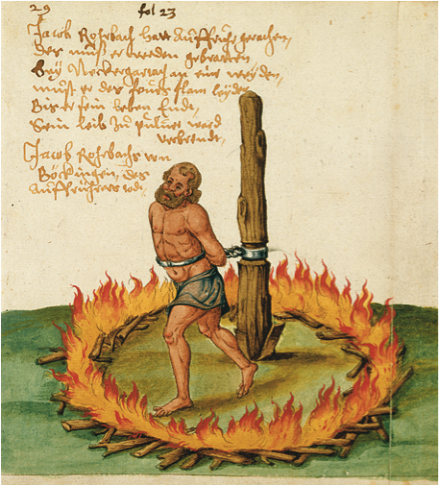
Notes:
The punishment of a peasant leader in a village near Heilbronn. After the defeat of rebellious peasants in and around the city of Heilbronn, Jacob Rorbach, a well-to-do peasant leader from a nearby village, was tied to a stake and slowly roasted to death.
Courtesy of the Library of Congress

Slide 18
Why was Luther successful?
Hus and Wycliffe had anticipated many of his teachings
Very much in-step with modern intellectual teachings on the Church and need for reform (Erasmus, others, stay with Rome.)
Luther offered more comprehensive alternative to Catholicism
German translations
Printing!!!
Forceful, gifted writer
Politically protected: Elector of Saxony; HRE cannot afford to suppress him…why?
Stop

Slide 19
The Swiss Reformation
Ulrich Zwingli (1484-1531)
  Humanist, influenced by Erasmus; memorized (!) Epistles!
  Humanistically educated; he credited Erasmus as setting him on path to reform.
  By 1518, known for his opposition to the sale of indulgences and also to religious superstition.
In 1519, city chooses Zwingli to become the people’s priest in Zurich.
  Ended priestly celibacy
  March 1522, broke the Lenten fast
  Preached the authority of Scripture alone: Attacked purgatory, saints, monasticism, clerical celibacy, the mass, the authority of the pope, and fasting.
Though Protestant, significant theological differences with Luther; prevented an alliance with German Protestants.
Dies in battle. Chopped into tiny pieces.
Swiss Civil war forced Swiss Catholics to recognize Protestants.

Slide 20
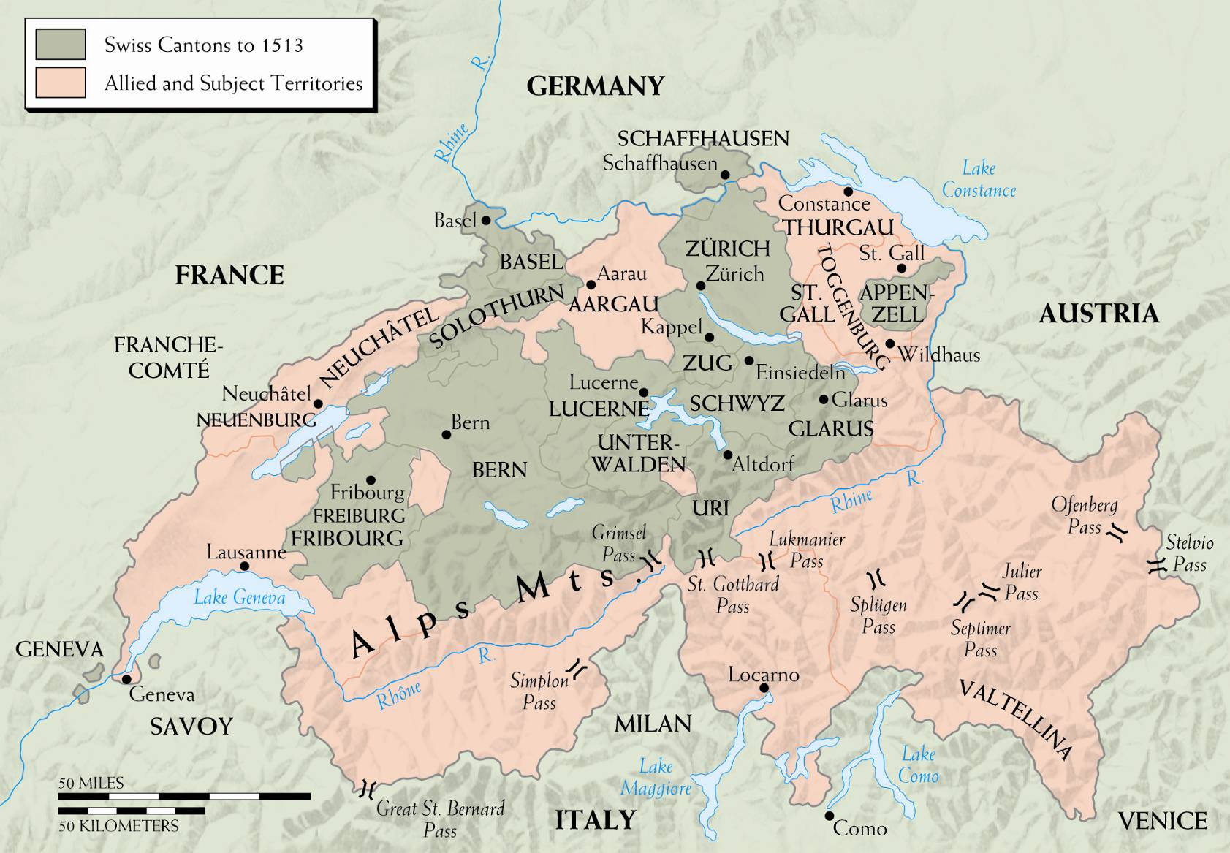
Notes:
THE SWISS CONFEDERATION Although nominally still a part of the Holy Roman Empire, Switzerland grew from a loose defensive union of the central “forest cantons” in the thirteenth century into a fiercely independent association of regions with different languages, histories, and, finally, religions.

Slide 21
Anabaptists
Radicals = Anti-state
Adult Baptism
Early Church = Communal
Separation of Church & State
Mennonites & Amish
Dutch emigrants led an Anabaptist takeover in 1534-1535.
The features of the regime included charismatic leaders and polygamy.
It was crushed by united Protestant and Catholic armies.

Slide 22
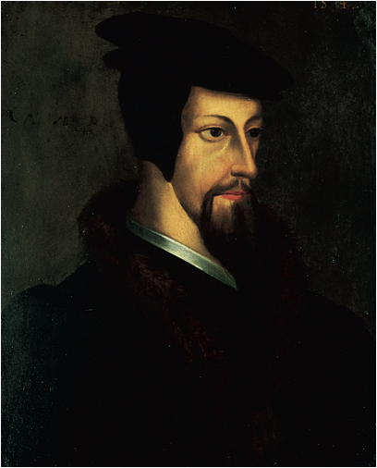
Notes:
A portrait of the young John Calvin.
Bibliothèque Publique et Universitaire, Geneva

Slide 23
John Calvin (1509-1564)
Born in France; studies theology in Paris, moves to study of law
May 1534, joined the Reformation.
Flees Francis I’s France for Switzerland
1536: Publishes The Institutes of the Christian Religion (at 25!)
Political revolt and religious reform in Geneva
  In the late 1520s, Genevans revolted; 1527 city council took power.
  May 21, 1536 Geneva officially adopted the Reformation. Hires Calvin and Guillaume Farel
June 1536, Calvin arrived in Geneva.
  All citizens REQUIRED to make public confession of new faith. Calvin kicked out.

Slide 24
Calvin’s Geneva
Calvin and Farel recalled to Geneva
Set up theocracy: “Holy Commonwealth”—Calvin becomes virtual dictator
  Penalties for skipping services, talking in church,. Execution if praise of the pope. All pleasures like singing, dancing, drinking are forbidden.)
Church organized into four offices
  Pastors
  Teachers to instruct the populace
  Elders, laypeople chosen by the council
  Deacons to dispense church goods and services to the poor
Consistory: Oversees morality
Predestination, the doctrine that only a chosen few are saved by God’s grace alone, without regard to acts or faith, was central to Calvin’s theology.

Slide 25
TULIP: Guide to Calvinist theology
T=Total depravity
  Man utterly sinful, incapable of redeeming self
U=Unconditional election
  Those chosen to salvation chosen unconditionally, not on works
L=Limited atonement
  Christ died for the elect, not all
I=Irresistible grace
  Grace not resistible for elect; no claim on merit
P=Persistence in grace
  Grace cannot be lost or rejected by elect

Slide 26
Diet of Augsburg
In 1530, Charles V presided over this meeting of Protestants and Catholics.
  The emperor ordered all Protestants to return to Catholicism.
February 1531, the Schmalkaldic League formed to defend Lutheran interests

Slide 27
Expansion and counter…
Throughout 1530s, German Lutherans formed regional consistories, judicial bodies which oversaw the new Protestant Churches.
The Reformation spread to Denmark and Sweden; made inroads in Poland.
In the 1540s, Charles V went after the Protestants.
  In 1547, he crushed the League, putting puppet rulers in Hesse and Saxony and forcing Protestants to return to Catholicism.
  Many Protestants fled to Magdeburg.

Slide 28
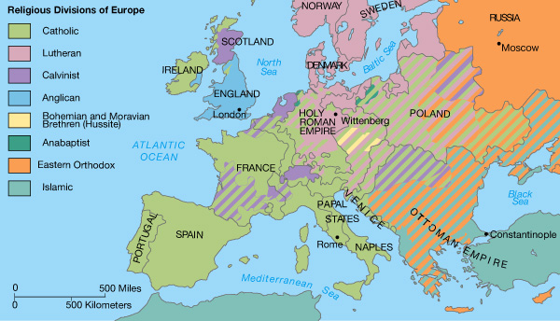

Slide 29
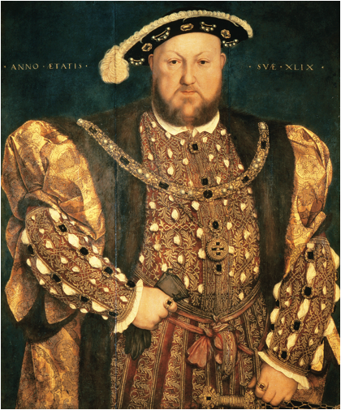
Notes:
Hans Holbein the Younger (1497–1543) was the most famous portrait painter of the Reformation. Here he portrays a seemingly almighty Henry VIII.
© Scala / Art Resource

Slide 30
The English Reformation
England was a likely breeding ground for Protestantism, but its advance was slow.
  England had a reputation for maintaining the authority of the crown against the pope
  There were already many secret Protestants.
  Lollardy and Humanism also were influences.

Slide 31
Henry VIII
Initially supported the Pope against Luther.
Henry’s first wife, Catherine of Aragon, did not provide him a son. He wanted an annulment in order to marry Anne Boleyn, which was not granted.
It was suggested that he declare himself supreme in English spiritual affairs, which would solve his problem.

Slide 32
“Reformation Parliament”
In 1529, Parliament convened for seven year session.
  Legislation passed: Put the clergy under the authority of king.
  January 1531: King officially the head of church in England.
  1532: Published official grievances against the church.
  1534: Ended all payments to Rome; gave Henry sole jurisdiction over ecclesiastical appointments.
Act of Supremacy (1534): Declared Henry “the only supreme head of the Church of England.”
Despite changes, Henry made few concessions to Protestant sensibilities; retained most ritual and doctrinal trappings of Catholicism.

Slide 33
Edward VI
When Henry died, then year-old son, Edward VI, took throne.
  Ruled under several regencies.
  Enacted series of reforms, bringing Church of England in line with Protestant England.
In 1553, Edward died, leaving Catholic half-sister Mary (“Bloody Mary”) as queen. She quickly reversed the reforms and tried to take England back to Catholicism.
Stop

Slide 34
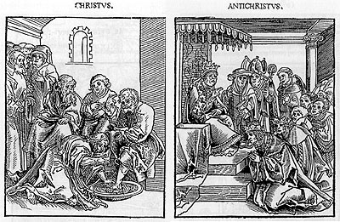
Christus/Anti-Christus (Lucas Cranach, 1536)

Slide 35
Catholic Reformation or Counter-Reformation?
Old polemical tradition: Divide Reformation & Counter-Reformation
But:
  Both Catholic and Protestant reforms draw on same sources: Humanist scholarship & widely-expressed critiques of late-Medieval Church
  Was a Counter-Reformation: 1550-1650

Slide 36
Document: “Constitution of the Society of Jesus”
What is the purpose of the Society of Jesus?
How will the Society achieve this?
To whom on earth is the Society to owe ultimate allegiance?
To what additional vow to all present and future popes is each new initiate bound?

Slide 37
The Counter-Reformation
Even before the Reformation, Catholics had begun to make efforts at reforms, but they were squashed.
Once the Reformation set in, new religious orders had begun to form.
  1524, Theatines to groom church leaders
  1528, the monastic Capuchins
The Jesuits were the most successful of the reform movements.
  Founded by Ignatius Loyola in the 1530s, it was recognized in 1540.
  Based on a military model, he wanted people to be “soldiers of Christ.”
  Preached self-mastery through discipline, self-sacrifice and obedience.

Slide 38
Council of Trent (1545–1563)
Success of the Reformation: Forced Church to call general council, in order to reassert doctrine.
  Liberal theologian Caspar Contarini to head a reform commission.
Council strictly under pope’s control. Most important reforms concerned internal discipline.
  Bishops needed to preach regularly and spend time in their dioceses.
  Priests were required to be neatly dressed, educated, strictly celibate.
No doctrinal concessions were made to the Protestants.
  They reaffirmed many key doctrines such as:
    The role of good works
    The authority of tradition
    Indulgences
Rulers initially resisted the reforms, but eventually the new legislation took hold.

Slide 39
Peace of Augsburg
The Reformation was too entrenched by 1547 to be ended.
  Puppet ruler of Saxony became a Lutheran.
  Emperor forced to relent.
September 1555, the Peace of Augsburg made the division of Christendom permanent.
  Cuius regio, eius religio, the ruler of a land determines its religion.
  Lutherans were permitted to retain church lands confiscated before 1552.
  It did not extend recognition to Anabaptists and Calvinists.

Slide 40
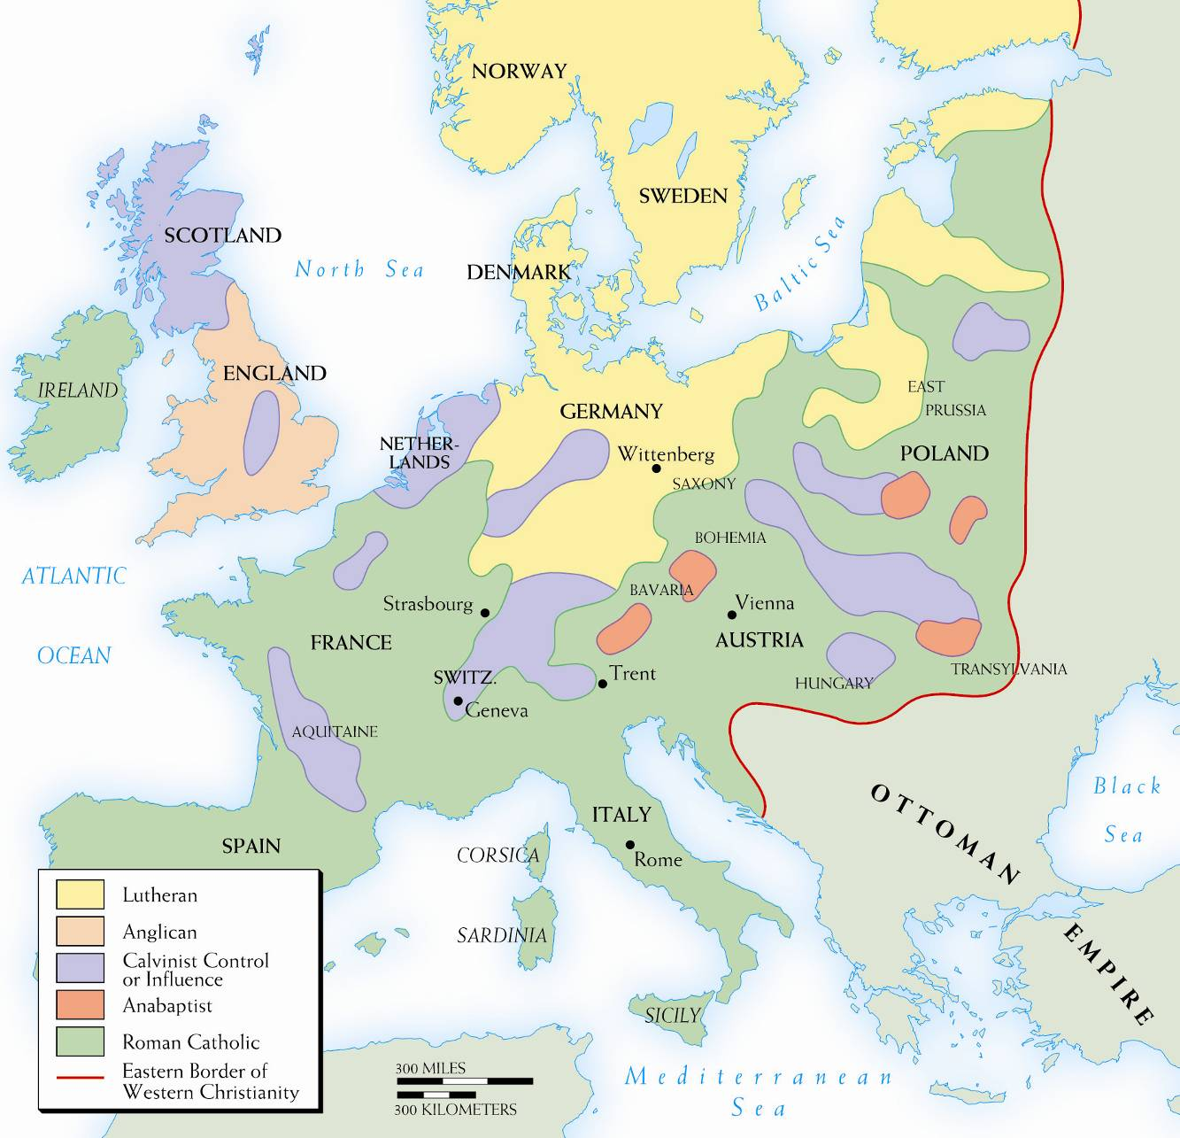
Stop
Copyright © 2010 Pearson Education, Inc., Upper Saddle River, NJ 07458. All rights reserved.
Notes:
Map 11–3 THE RELIGIOUS SITUATION ABOUT 1560 By 1560, Luther, Zwingli, and Loyola were dead, Calvin was near the end of his life, the English break from Rome was complete, and the last session of the Council of Trent was about to assemble. This map shows “religious geography” of western Europe at the time.

Slide 41
Society in 16th century Europe

Slide 42
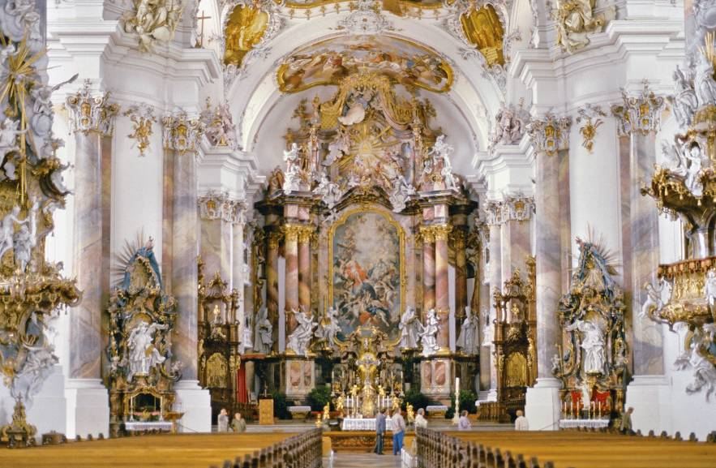
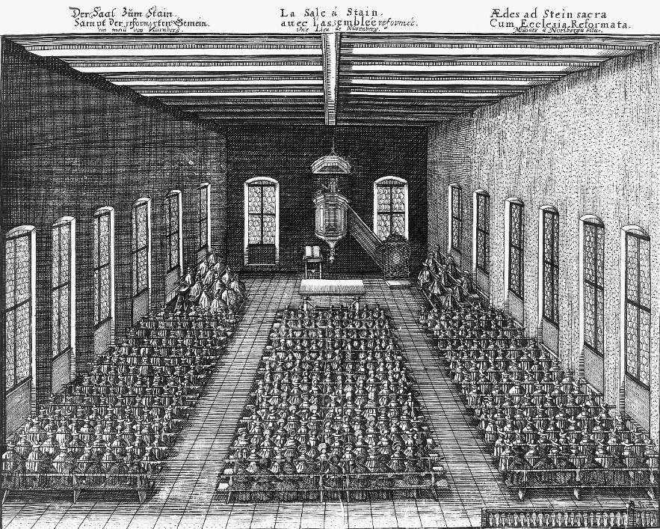
Notes:
Baroque and Plain Church: Architectural Reflections of Belief Contrast between an eighteenth-century Catholic baroque church in Ottobeuren, Bavaria and a seventeenth-century Calvinist plain church in the Palatinate. The Catholic church pops with sculptures, paintings, and ornamentation, while the Calvinist church has been stripped of every possible decoration.
TOP: Vanni/Art Resource, NY
BOTTOM: German National Museum, Nuremberg, Germany

Slide 43
Religious Life in
Fifteenth-Century (Later Protestant) Cities
The clergy were ubiquitous.
Daily life was regulated by the calendar, with frequent fasts and festivals.
Monasteries and nunneries were influential institutions.
Even many Catholic clergy had concubines and children, and were often resented by lay people.

Slide 44
Religious Life in
Sixteenth-Century Protestant Cities
There were far fewer clergy.
The number of holidays shrunk by a third.
Cloisters had nearly disappeared.
Protestant clergy were still resented.

Slide 45
Education
  The Reformation had a profound effect on education, as it implemented humanistic educational reforms.
  Counter-reformers emphasized the classic Scholastic writers: Lombard, Bonaventure and Aquinas.
  Some humanists thought that the Protestant co-option of their curricula narrowed it; however, the Reformation spread humanist ideas farther than they had been before.

Slide 46
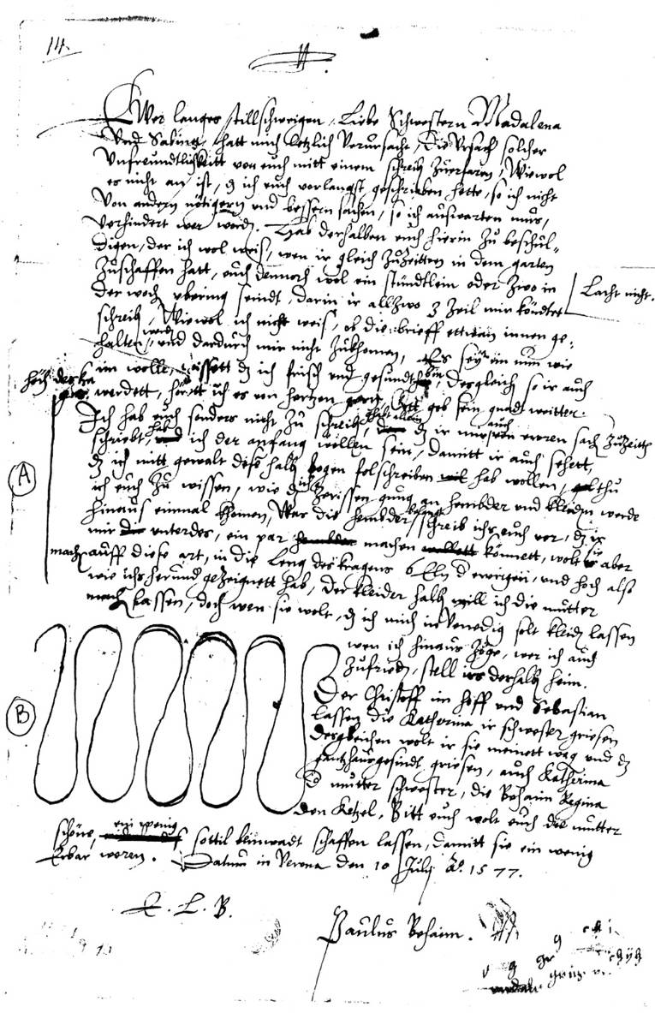
Notes:
Brothers and Sisters. While away from home at law school in Padua, Italy, nineteen-year-old Paul Behaim, Jr., wrote in July 1577 to his older sisters Magdalena (twenty-two) and Sabina (twenty-one) to complain about the infrequency of their writing to him. Typical of sibling relations in every age, the letter is affectionate and joking. The sisters were then at home with their widowed mother and busy with the many chores of the self-sufficient sixteenth-century domestic household—especially, at this time of the year, gardening. Because of their alleged neglect Paul teasingly tells them they must now do “penance” by making him two new shirts, as his were embarrassingly tattered. He indicated in the left margin the exact collar length (A) and style (B) he wishes the shirts to be. Sewing for the household was another regular domestic chore for burgher and patrician women not working in trades outside the home. But Magdalena and Sabina went even further to “cover” their brother: They also allowed him to receive income (to be repaid in the future) from their own paternal inheritances so he might finish his legal education, on the successful completion of which the whole family depended for its future success.
German National Museum, Nuremberg, Germany, Behaim-Archiv Fasz, 106

Slide 47
Women
The Protestant rejection of celibacy accompanied their rejection of the Medieval tendency to degrade women as temptresses or exalt them as virgins. Instead, they praised women as mothers and housewives.
Marriage was viewed as a partnership between man and wife.
  Women had the right to divorce and remarry, just as men did.
  However, wives remained subject to their husbands.

Slide 48
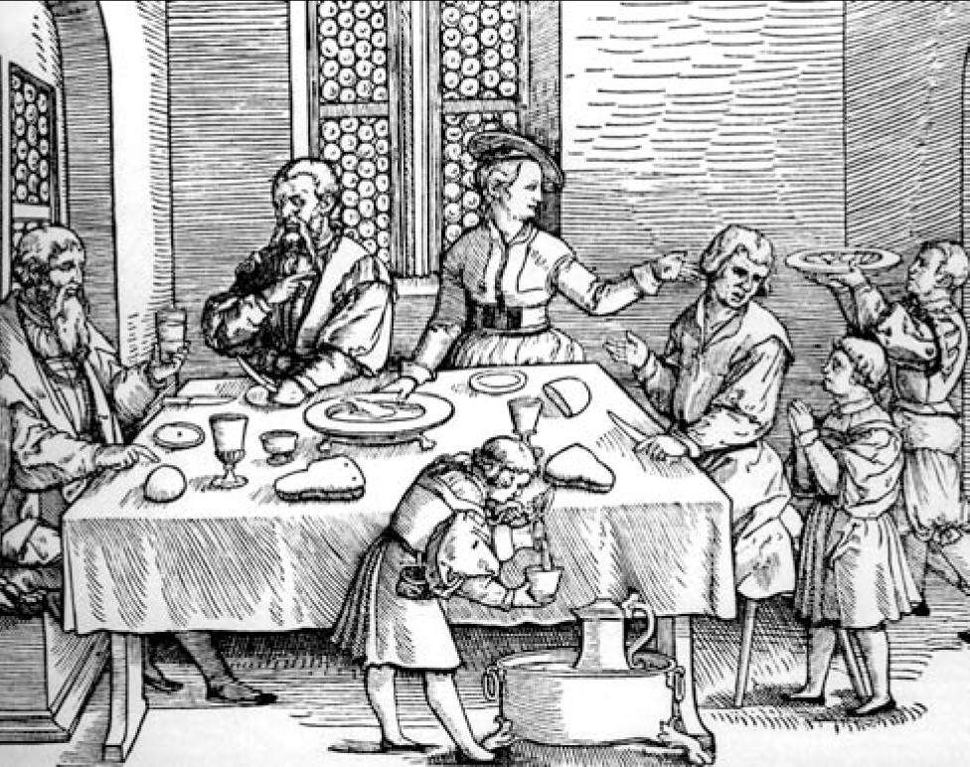
Notes:
A Family Meal.
In Max Geisberg, The German Single-Leaf Woodcuts, III: 1500–1550, rev. and ed. by W. L. Strauss (New York: Hacker Art Books, 1974)

Slide 49
Family Life in
Early Modern Europe
Between 1500 and 1800, men and women married later than they had before.
  Men: mid to late 20s
  Women: early to mid 20s
Marriages tended to be arranged, however it was usual for the couple to have known each other, and their feelings were often respected.
Families consisted of two parents and two to four children.
The church and physicians condemned those who hired wet nurses.
The traditional family had features that seemed cold and distant. The pragmatic was often stressed over the romantic.

Slide 50
Literature
The Reformation did not only bring about cultural and changes. There were also major innovations in literature.
  Miguel De Cervantes Saavedra was a Spanish writer.
    His major work was Don Quixote, which was a satire of the chivalric romances popular in Spain. The juxtaposition of idealism and realism in the novel was very innovative.
  William Shakespeare was an English playwright.
    He wrote histories, tragedies and comedies.
    His work struck universal human themes, many of which were rooted in contemporary religious traditions.

