Slide 1
Mercantilism, the Transatlantic Economy, Trade Wars, and Colonial Rebellion
Silver and Gold…

Slide 2
Questions…
  Why do countries trade?
  What do they gain?
  Is international trade a win-lose competition or a win-win situation? Why?
  If a competition, who wins? How?
  What is a “balance of trade”?
  What is the current US bot?
  Is it good or bad to have a negative balance of trade?

Slide 3
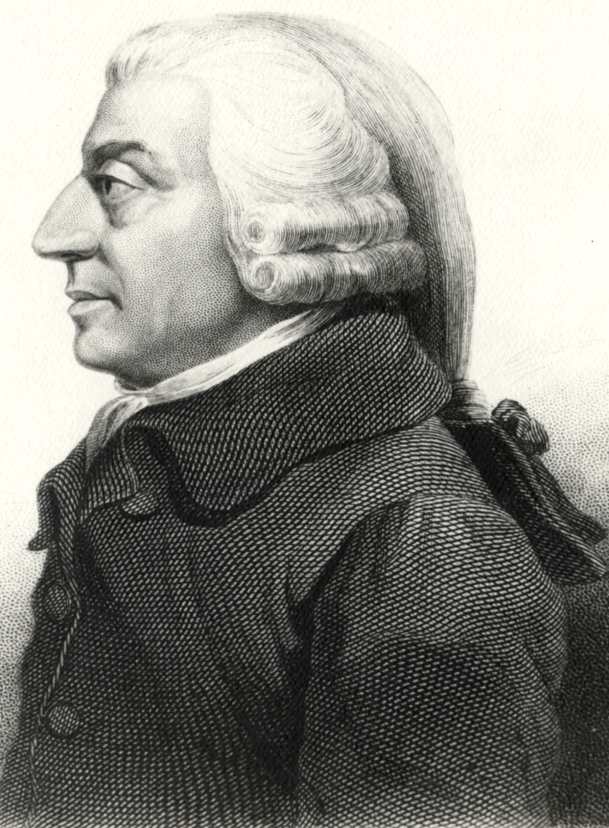
Adam Smith
Father of modern economics
Wealth of Nations (1776)
Theory of Absolute Advantage and specialization

Slide 4
Dominant Economic Systems
Feudalism (1000s – ca. 1500)
Mercantilism (1500s – 1700s)
Free-enterprise (1700s – 1918)
Socialism/Keynesianism (1918 – 1989)
Free-enterprise (1980s – 2008)
?

Slide 5
Feudalism
Emphasis on agricultural production
Who controlled what?
  Kings: Money and security
  Nobles: Agriculture
  Merchants: Trade
  Priests: Behavior
  Serfs: Nothing

Slide 6
What caused the end of feudalism?
Black Death decreases labor supply
Travel increases trade possibilities
Rise of the individual and private property and the middle class

Slide 7
Opening Questions
What was mercantilism?
What were the two main objectives of mercantilist countries?
Why would mercantilist countries pursue colonies?

Slide 8
Mercantilism
Economics subordinated to the interest of the state:
  Collect more specie (gold & silver) than all other states
  Maintain a positive balance of trade (Export more than one imports)
Read excerpt “Mercantilism and Colonization”

Slide 9
Factors leading to mercantilism
Rise of the nation-state
Commercial revolution
Decline of the medieval economy

Slide 10
Practice of mercantilism
External policies
  Favorable balance of trade
  Merchant marine (& navy)
  Colonial system
Internal policies
  Regulation of prices and wages
  Regulation of labor
  Regulation of consumption

Slide 11
Political implications of mercantilism
Assertion of national power
  Assumption that welfare of community will follow pursuit of national strength
Duties of classes
  Laborer’s lot: Poor, but not impoverished
  Responsibilities of the rich:
    Consume, but only to increase the power of the state
  Merchant's duty: Produce to enhance store of gold
  Obligations of the nobility: Produce sufficient food and raw materials

Slide 12
Harmony of interests
Well-ordered national community
  No inherent conflict between or among the groups
A moral community
A visible and omnipresent hand

Slide 13
The international anarchy among states
Assumption of nothing but conflict and war
Economic competition was political rivalry
Commercial transactions are always political

Slide 14
Increase in Military Manpower, 1470-1710
Date | Spain | Dutch | France | England | Sweden | Russia
1470 | 20,000 |  | 40,000 | 25,000
1550 | 150,000 |  | 50,000 | 20,000
1590 | 200,000 | 20,000 | 80,000 | 30,000 | 15,000
1630 | 300,000 | 50,000 | 150,000 |  | 45,000 | 35,000
1650 | 100,000 |  | 100,000 | 70,000 | 70,000
1670 | 70,000 | 110,000 | 120,000 |  | 63,000 | 130,000
1700 | 50,000 | 100,000 | 400,000 | 87,000 | 100,000 | 170,000

Slide 15
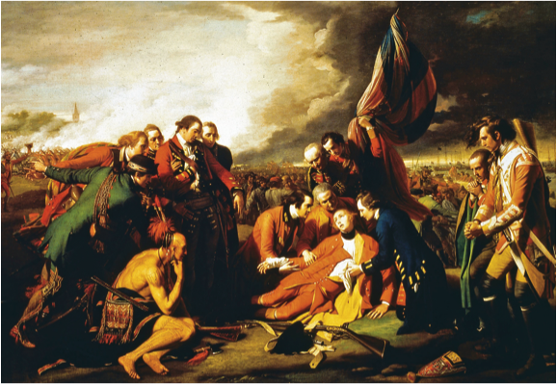
Notes:
General James Wolfe was mortally wounded during his victory over the French at Quebec in 1759. This painting by the American artist Benjamin West (1738–1820) became famous for portraying the dying Wolfe and the officers around him in poses modeled after classical statues.
Getty Images Inc.—Hulton Archive Photos

Slide 16
Overview
Mid-18th c. renewal of European warfare:
  Austria vs. Prussia over dominance of central Europe
  Great Britain vs. France for commercial & colonial supremacy
Outcomes: Prussia emerges as great power, Great Britain gains world empire
Peace results in restructuring of taxation & finance, leading in turn to:
  American Revolution
  Continental enlightened absolutism
  Continuing French financial crisis
  Reform of Spanish South American empire

Slide 17
European Overseas Empires
Four phases of European contact with the New World:
  Discovery, exploration, conquest, settlement—to end of 17th c.
  Mercantile empires & great power trade rivalries; slavery; colonial independence—to 1820s
  19th-c. empires in Africa & Asia
  Decolonization, mid- to late-20th c.
Source of European world domination: technology (ships & guns)

Slide 18
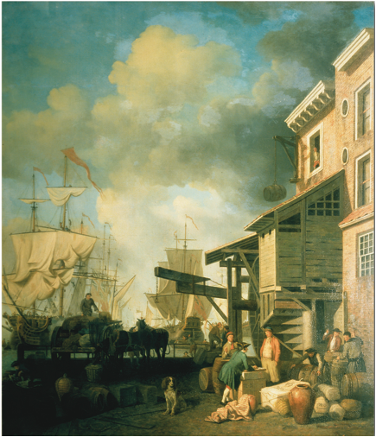
Notes:
During the seventeenth and eighteenth centuries, European maritime nations established overseas empires and set up trading monopolies within them in an effort to magnify their economic strength. As this painting of the Old Custom House Quay in London suggests, trade from these empires and the tariffs imposed on it were expected to generate revenue for the home country. But behind many of the goods carried in the great sailing ships in the harbor and landed on these docks lay the labor of African slaves working on the plantations of North and South America.
Samuel Scott “Old Custom House Quay” Collection. V & A Images, The Victoria and Albert Museum, London

Slide 19
Mercantile Empires, Early 18th c. —Boundaries Set by 1713 Treaty of Utrecht
Spain: South America except for Brazil; Florida, Mexico, California & N. American Southwest; Central America; Caribbean possessions
Britain: N. Atlantic seaboard, Nova Scotia, Newfoundland; Caribbean possessions; trading posts on Indian subcontinent
France: St. Lawrence, Ohio, & Mississippi river valleys; Caribbean possessions; trading posts in India & West Africa
Netherlands: Surinam (S. America); Cape Colony (S. Africa); trading posts in West Africa, Sri Lanka, & India; also controlled trade with Java in SE Pacific

Slide 20
Mercantilist Goals
Underlying economic theory of 18th-c. empires
International trade as zero-sum game; whoever gets the most gold wins
Colonies meant to trade exclusively with home country; hard to enforce because it was more profitable to trade with other colonies

Slide 21
French-British Rivalry
N. American colonial quarrels over St. Lawrence River valley, upper New England, Ohio River valley; fishing rights, fur trade, Native American alliances
Biggest area of rivalry: West Indies—tobacco, cotton, indigo, coffee, sugar
India: Rival monopoly traders

Slide 22
Trade Regulation
Only one port authorized for use in American trade: Cadiz
Casa de Contración regulated all trade with New World
Functioned to serve Spanish commercial interests (precious-metal mines)
Flota system tried to ensure Spanish economic hegemony

Slide 23
African Presence in Americas
Had always existed in some form in parts of Europe, but from 16th c., became fundamental to the British & Spanish imperial economies (plantation economy)
Driven by labor shortage
Supplied by internal African warfare: slave markets on West African coast—not imposed by Europeans, but preexisting
Began in 16th c. in Spanish America, 17th c. in British America
Slave trade grew in 18th c. because of low fertility rate and high mortality rate of established slaves—difficult to create stable self-reproducing population

Slide 24
Slavery and the
Transatlantic Economy
Slave trade: dominated by Portuguese & Spanish in 16th c., Dutch in 17th c., and English in 18th c.
“Triangular trade”

Slide 25
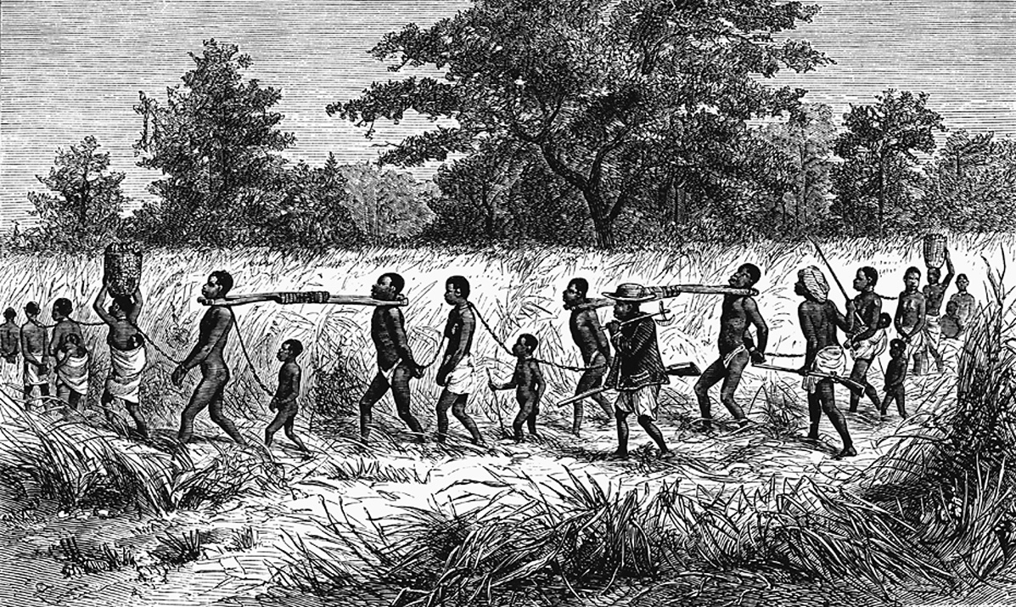
Notes:
This eighteenth-century print shows bound African captives being forced to a slaving port. It was largely African middlemen who captured slaves in the interior and marched them to the coast.
North Wind Picture Archives

Slide 26
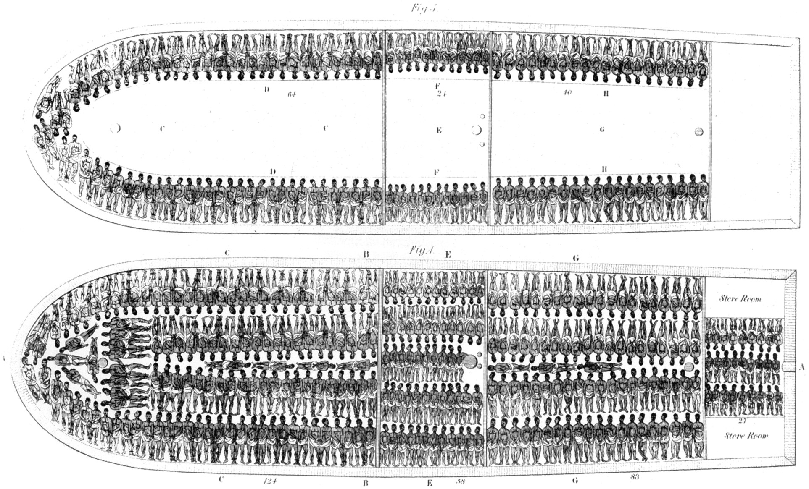
Notes:
The Slave Ship Brookes This print records the main decks of the 320-ton slave ship Brookes.
Photographs and Prints Division, Schomburg Center for Research in Black Culture, The New York Public Library, Astor, Lenox and Tilden Foundations

Slide 27
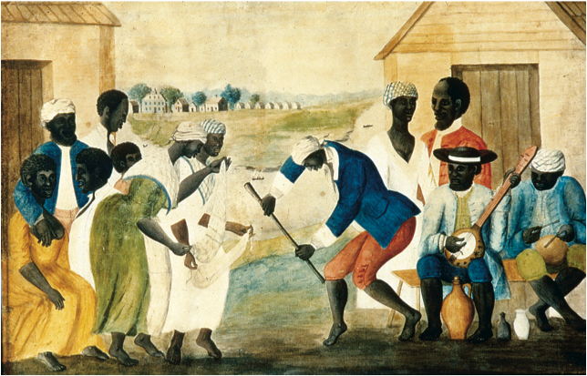
Notes:
Slaves on the plantations of the American South were the chattel property of their masters, and their lives were grim. Some artists sought to disguise this harsh reality by depicting the lighter moments of slave society as in this scene of slaves dancing.
Getty Images Inc.—Hulton Archive Photos

Slide 28
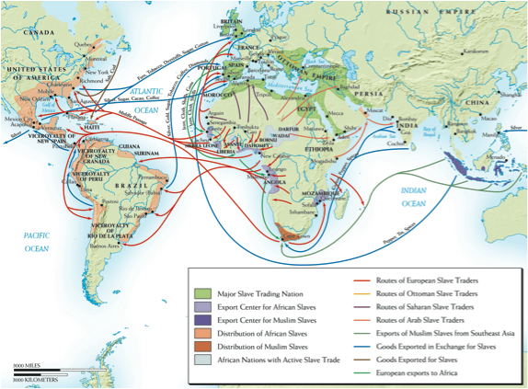
Notes:
Map 16–2 THE SLAVE TRADE, 1400–1860 Slavery is an ancient institution and complex slave-trading routes were in existence in Africa, the Middle East, and Asia for centuries, but it was the need to supply labor for the plantations of the Americas that led to the greatest movement of peoples across the face of the earth.

Slide 29
The Experience of Slavery
Estimated 9 million Africans or more brought to Americas over 4 centuries
“Seasoned” slaves worth more than those newly arrived
Maintenance of ethnic bonds in the New World—African language, religion
Generally accepted that all the slaves in plantation societies led difficult lives with little variation
Some slaves mixed Christianity with African religions
One of factors that continued slavery was racist ideology

Slide 30
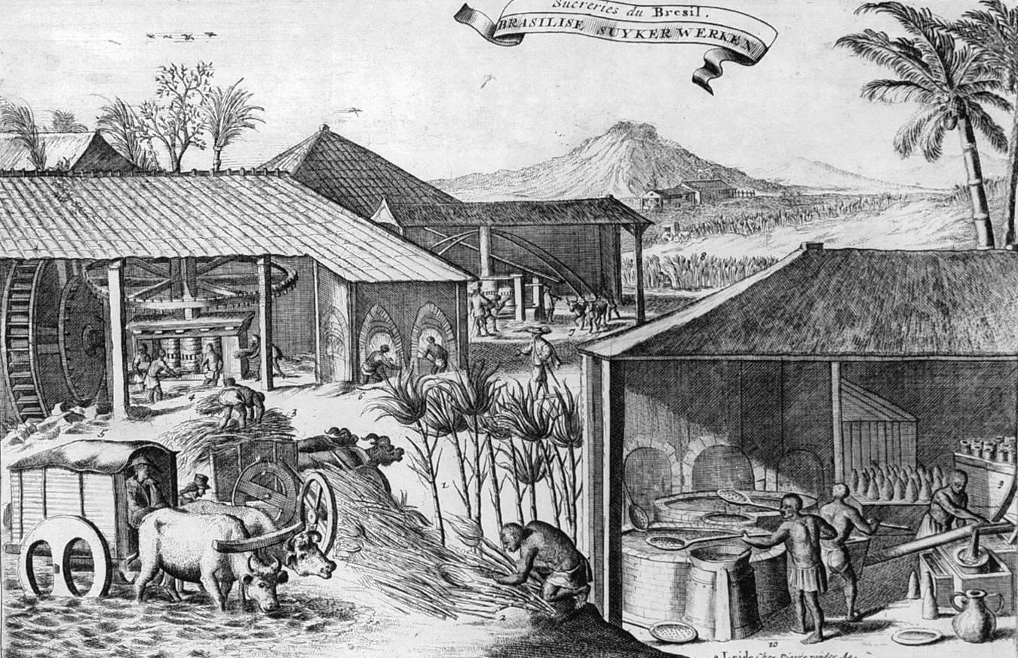
Notes:
Sugar was both raised and processed on plantations such as this one in Brazil.
© Hulton-Deutsch Collection/CORBIS

Slide 31


Slide 32
Global Competition and the Balance of Power in the 18th Century
Winners
Losers
UK
Russia
Prussia
Austria
Poland-Lithuania
Ottoman Empire
France (?)
Netherlands
Sweden
Spain

Slide 33
The Spanish Colonial System
Colonial Government
  The technical link between New World and Spain was crown of Castile
  Top-down administration, almost no self-government

Slide 34
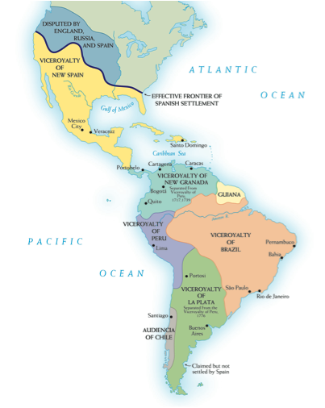
Notes:
Map 16–1 VICEROYALTIES IN LATIN AMERICA IN 1780 The late eighteenth-century viceroyalties in Latin America display the effort of the Spanish Bourbon monarchy to establish more direct control of the colonies. They sought this control through the introduction of more royal officials and by establishing more governmental districts.

Slide 35
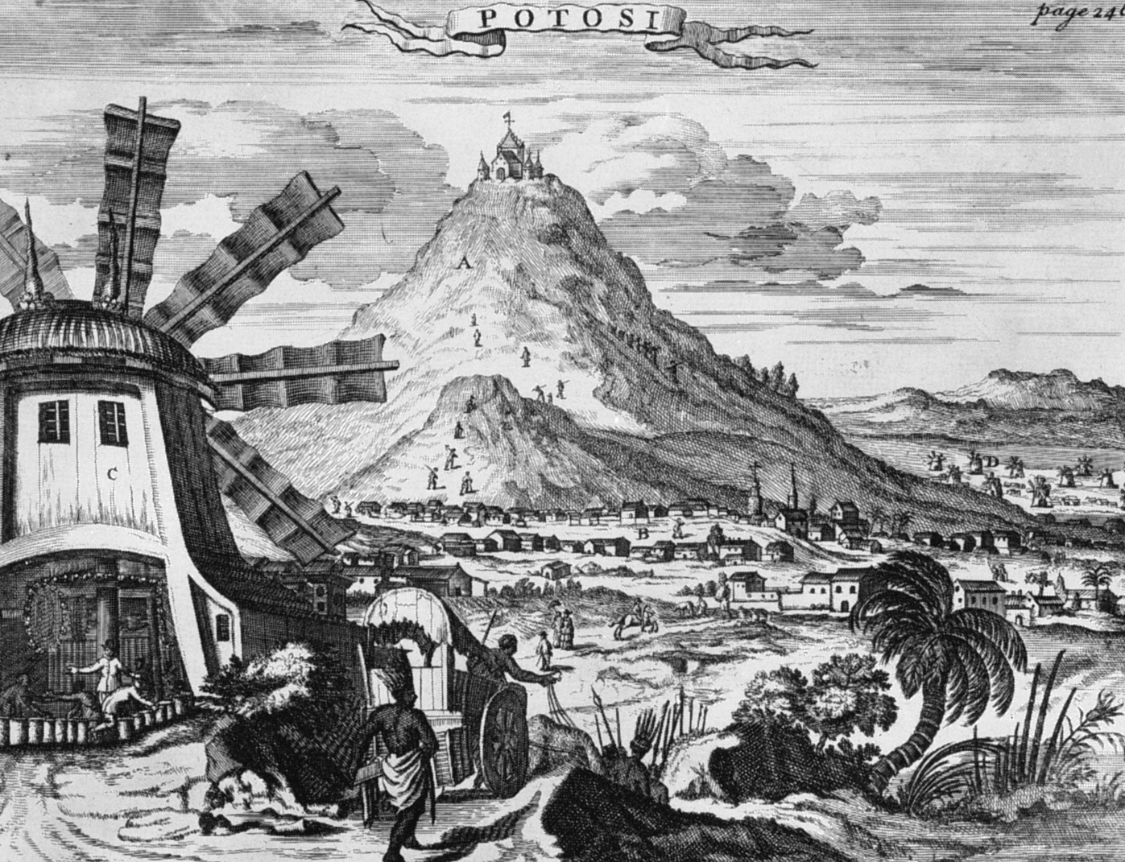
Notes:
The Silver Mines of Potosí. Worked by conscripted Indian laborers under extremely harsh conditions, these mines provided Spain with a vast treasure in silver.
Hulton/Corbis-Bettmann

Slide 36
Trade Regulation
Only one port authorized for use in American trade: Cadiz
Casa de Contración regulated all trade with New World
Functioned to serve Spanish commercial interests (precious-metal mines)
Flota system tried to ensure Spanish economic hegemony

Slide 37
Balance of Power
Fluid with alliances changing
Seeking dynastic and global power
Expand power through marriage, inheritance, alliance, and war
Rule: No state may become too powerful
Global economy=Rivalries among Spain, Netherlands, UK, and France
  Wars spread to Americas and India
  Motivated by mercantilism

Slide 38
Colonial Reform Under the Spanish Bourbon Monarchs
Crucial early 18th-c. change: War of the Spanish Succession (1701–1714) and Treaty of Utrecht replaced Spanish Habsburgs with Bourbons of France
Philip V (r. 1700–1714) and successors tried to revive decaying trade monopoly, suppress smuggling
Charles III (r. 1759–1788): most important imperial reformer—royal representatives favored over local councils; improved imperial economy, but introduced tensions between Spanish from Spain and creoles (Spanish born in America)

Slide 39
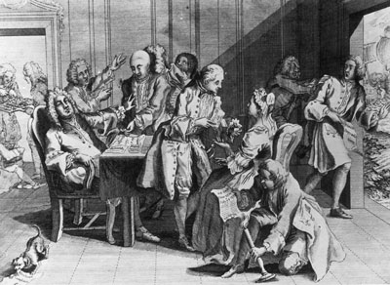
Mid-Eighteenth-Century Wars
War of Jenkins’ Ear (1739)
  English-Spanish competition in West Indies
  British declared war on Spain in 1739
  Minor war was opening encounter to European warfare up to 1815

Slide 40
End of Dynastic Struggle in Britain
Two Stuart attempts at seizing the throne:
  “The ‘15”: Jacobites, led by James III, Anne’s ½ brother, rise in Scotland in opposition to George I Hanover (“King Log”)
  “The ‘45”: Charles Edward Stuart (“Bonnie Prince Charlie”) leads troops against George II

Slide 41
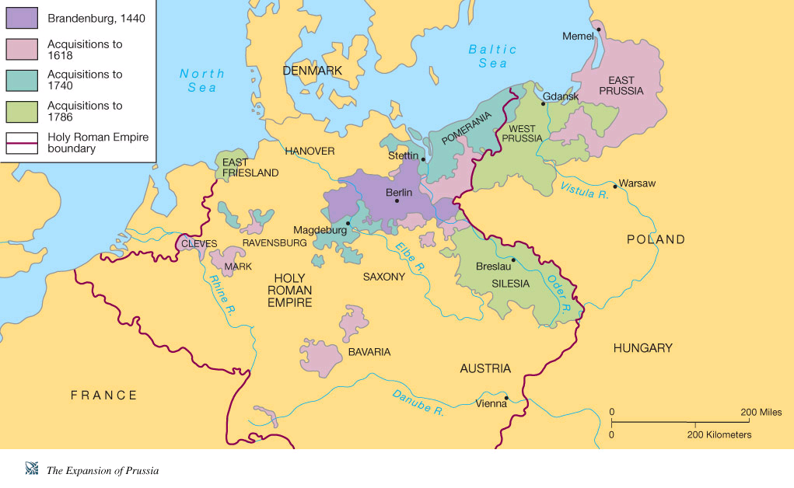

Slide 42
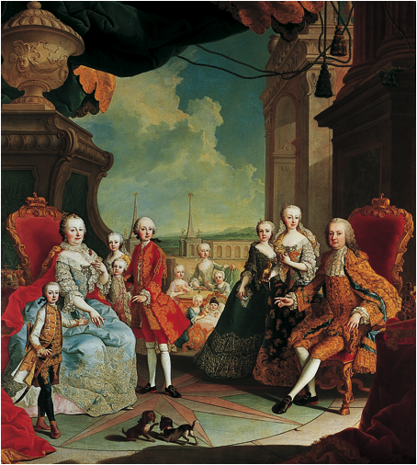
Notes:
Maria Theresa of Austria provided the leadership that saved the Habsburg Empire from possible disintegration after the Prussian invasion of Silesia in 1740.
Martin van Meytens: “Kaiserin Maria Theresia mit ihrer Familie auf der SchloBterasse von Schobrunn.” Kunsthistorisches Museum, Vienna, Austria

Slide 43
Foes in the War of the Austrian Succession
Austrian Allies
Prussian Allies
Austria
Russia
Denmark
Sweden
Piedmont-Sardinia
Prussia
France
Spain
Bavaria (HRE)

Slide 44
War of the Austrian Succession (1740–1748)
Charles VI (r. 1711-1740) determined to keep lands Habsburg
Pragmatic Sanction: All lands to remain under Habsburg heir, male or female
Maria Theresa (r. 1740-1780) v. Frederick II (the Great) (r. 1740-1786)
Prussia invades (Habsburg) Silesia
France invades Austrian Netherlands
Diet of Pressburg – Maria Theresa rallies nobles to her
England allies with Austria after French advances
  King George II becomes last English monarch to fight
War spreads world-wide

Slide 45
War of Austrian Succession (cont.)
War spreads worldwide
  India: French forces capture Madras in 1746
  Americas: (“King George’s War”)
    British capture Louisburg in Nova Scotia in 1745
War ends with exhaustion
Ended with Treaty of Aix-la-Chapelle in 1748
  All lands captured, except Silesia, returned
  Prussia’s new power status recognized
  Maria Theresa maintains Hapsburg empire as a major political power—Her husband elected HRE
  Stage set for a greater conflict

Slide 46
The “Diplomatic Revolution” of 1756
Maria Theresa seeks to regain Silesia
From 1753 works with Imperial Chancellor Count Wenzel von Kaunitz to reverse traditional alliances
  250 years of old alliances reversed
Austria switches alliance to France, then adds Russia
  Austria wants Silesia back
  France wants Austrian Netherlands
Great Britain joined forces with Prussia,
  Convention of Westminster
France and Austria agreed to defensive alliance
  France to receive Austrian Netherlands
  Austrian neutrality in French war with Britain in the Americas
  Princess Marie Antoinette sent to marry the future Louis XVI in 1770

Slide 47
Changing Alliances in the Seven Years’ War
Austria
Prussia
France
Russia
Sweden
Saxony
Spain
Britain
Portugal

Slide 48
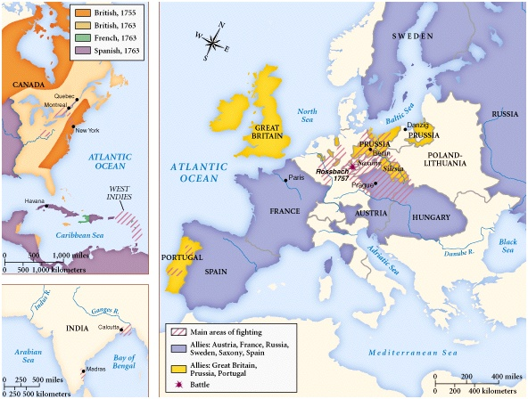

Slide 49
Seven Years’ War (1756–1763)
Remarkable conflict:
  First truly global war
  Britain and France clash in North America, Caribbean, India
  Not a war of kings, but of nations
  Popular war in England, France
Prussia preemptively attacks Saxony
  Frederick defeats French army, then Austrians in 1757
  Russia sweeps in and occupies Berlin
  “Miracle of the House of Brandenburg” (1762)
    Empress Elizabeth dies; Czar Peter III leaves war

Slide 50
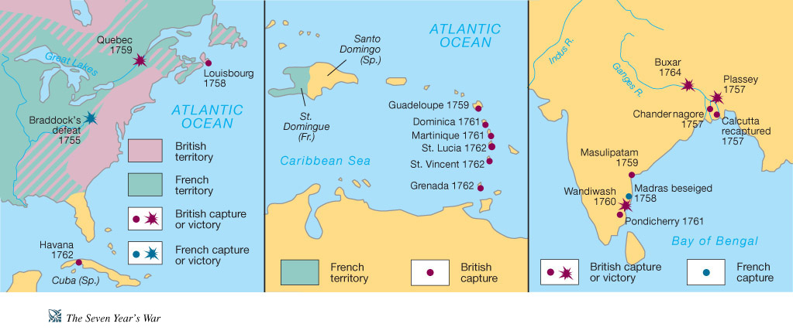

Slide 51
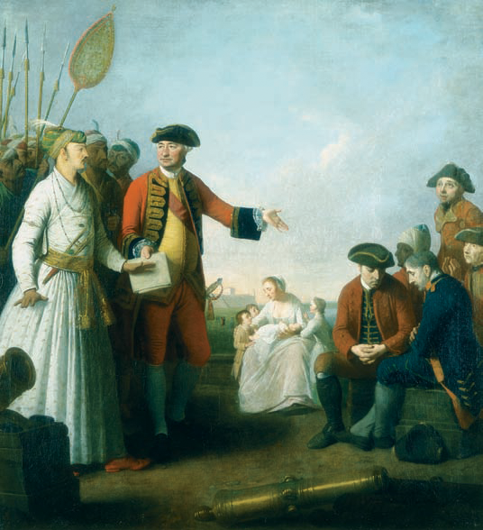
Notes:
This scene, painted by artist Edward Penny, shows Robert Clive receiving a sum of money from Siraj-ud-daulah, the Mughal Nawab of Bengal, for injured officers and soldiers at Plassey. Clive’s victory in 1757 at the Battle of Plassey brought English domination of the Indian subcontinent for almost two centuries. Clive had won the battle largely through bribing many of the Nawab’s troops and potential allies.
Erich Lessing © The Trustees of the British Museum/Art Resource, NY

Slide 52
Seven Years’ War around the world
Britain subsidizes Prussia, but focuses on war overseas
Clashes in America had started in 1754 between British and French forces (“French and Indian War”)
  Great Lakes
  Ohio River Valley
  Fort Duquesne becomes Fort Pitt (1758)
British forces capture Quebec in 1759, take Caribbean islands
French defeat spells end of New France
  Acadians evicted to Louisiana
India: British forces under Clive take French bases and defeat Indian princes
Naval victories in 1759 decisive: Britain clearly major naval power

Slide 53
Treaties of Hubertusberg and Paris (1763)
France gives up overseas empire—cedes Louisiana to Spain
Britain gains India, Canada, and Florida (Pitt: “France lost America in Germany”)
Austria forced to accept loss of Silesia
Prussia’s Great Power standing confirmed
War of Bavarian Succession, 1778-79 (“Potato War”)
“Eastern Powers” – Russia, Prussia come into their own
Costs and successes challenge British Empire

Slide 54
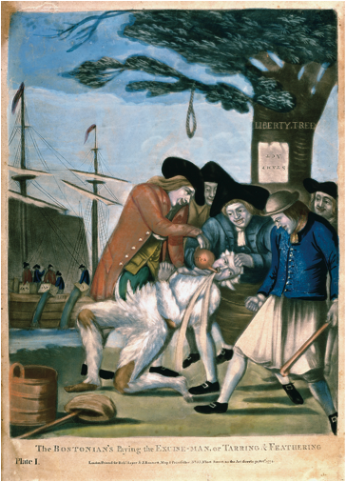
Notes:
Many Americans fiercely objected to the British Parliament’s attempts to tax the colonies. This print of a British tax collector being tarred and feathered warned officials of what could happen to them if they tried to collect these taxes.
Philip Dawe (c. 1750-C.1785), “The Bostonians paying the Excise-Man or Tarring & Feathering.” London, 1774. Colored Engraving. The Gilder Lehman Collection on deposit at the Pierpont Morgan Library. GL 4961.01. Photography: Joseph Zehavi.
The Pierpont Morgan Library/Art Resource, NY

Slide 55
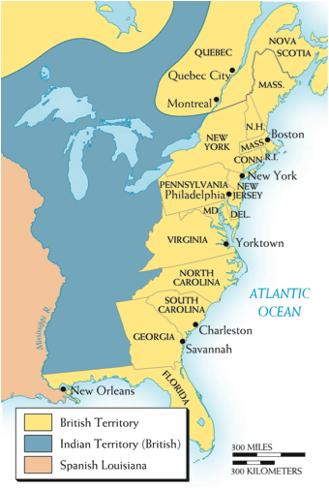
Notes:
Map 16–3 NORTH AMERICA IN 1763 In the year of the victory over France, the English colonies lay along the Atlantic seaboard. The difficulties of organizing authority over the previous French territory in Canada and west of the Appalachian Mountains would contribute to the coming of the American Revolution.

Slide 56
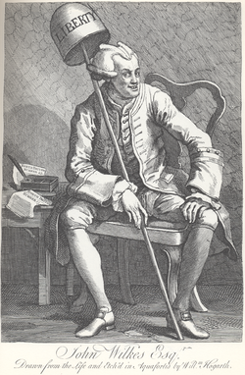

Slide 57
Events in Great Britain
1760s: Call for political reform
  Electoral reform
  Redistricting
  Liberty!
John Wilkes affair
  Malt distiller’s son
  Arrested after criticizing treaty with France in print (1763) (North Briton, no. 45)
  King wants him arrested for libel
  Flees to France to escape pornography charge
  Elected several times to Parliament but Parliament would not sit him
  First true populist party politician
  “Wilkes and Liberty!”

Slide 58
The English Colonies in America
13 colonies collectively many times the size of England
  Population:
    1700 – 250,000
    1775 – 2,500,000
    England: 6,500,000
  Not unified
  Land very cheap = More voters
  Become used to “salutary neglect”
  Raise own local taxes
  Fixated on actual rights as Britons and fictitious “liberty”
  South = plantation slave economy
  North = produce rum and refined sugar
  Manufacturing limited

Slide 59
British Rule Over Colonies
Navigation Act keeps foreigners out of trade
Crown taxes low or non-existent
Central rule light
After 1688, William III restores powers to local assemblies

Slide 60
British Policy
After 1763, Britain attempts to deal with:
  Native Americans: 1763 native sovereignty recognized over western territories – colonists infuriated
  French colonists: Quebec Act (1774) - Reaffirms French legal system, legalizes Catholic church, restore land between Ohio and Mississippi to colonists – colonists infuriated
  British colonists on eastern seaboard – little collective consciousness

Slide 61
Paying for Victory
1763, American colonists revel in identity as victorious Britons and celebrate rights and liberties
Paying for victory
  Grenville (succeeds Pitt in 1763): Budget deficit £122 million
  Britons pay 26d each to Imperial coffers, MA residents 1d
  British argument: War was fought largely on behalf of colonists; colonists receive protection of British army and navy; should help in paying

Slide 62
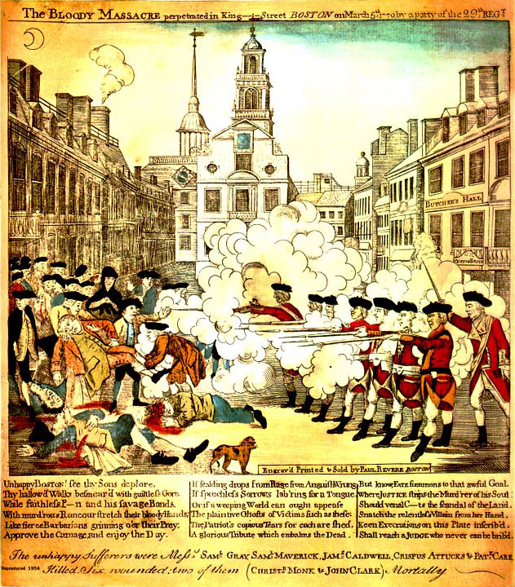

Slide 63
Colonial Overreaction I
Stamp Act (1765)
  Colonists claim arbitrary taxation
  Colonial assemblies, Sons of Liberty, Stamp Act Congress proposes commercial boycott
  Repealed in 1766
  Declaratory Act: Parliament asserts right to legislate for colonists
  Boston mob attacks home of presumed tax collector
Next decade: Tax, resist, repeal, pass another
March 1770: Boston mob attacks British unit while protesting quartering of British troops= Five killed

Slide 64
Colonial Overreaction II
Lord North (PM 1770) sponsors Tea Act (1773)
  Aid East India company
  Ship surplus tea to colonies, crown collects revenue
  Significantly drops the price of tea, but reasserts crown’s right to tax
  Boston “Tea Party” (1773)
    Protestors destroy £10,000 of tea
    Franklin: “An act of piracy, Americans should repay.”
“Intolerable Acts” (1774): Port closed until Bostonians reimburse merchants and the Company
First Continental Congress (1774)
Lexington & Concord (April 1775)
  Massachusetts militia guerillas attack and kill 250 British troops

Slide 65
Unwinnable War
Colonists begin w/o army or navy
British forces professional
British fighting 3,000 miles from home against people fighting for own homes
Communications, intelligence, orders delayed by months
British have no important allies
  French, Spanish, Dutch aid American cause
Whigs in Parliament, merchants at home oppose war as unnecessary, expensive, and wrong

Slide 66
A Rebellion, not a Revolution
Colonists’ cause conservative
Revolution fought by landowners and businessmen over the same issues as the English Civil War and the Glorious Revolution
Colonists claim to rebel in defense of English liberties
  Cite Petition of Right (1628) (martial law and billeting)
  Free trade with the empire through Navigation Acts
  Declaration of Rights (1629) (taxation w/o representation)

Slide 67
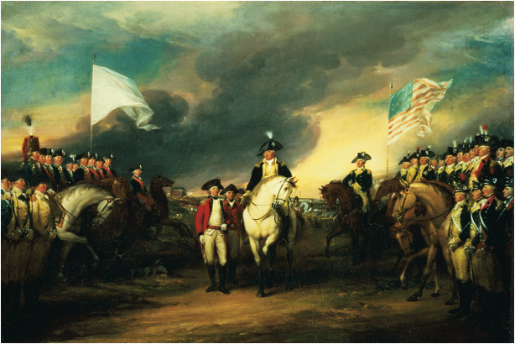
Notes:
The surrender of Lord Cornwallis’ British army at Yorktown, Virginia, in 1781 to American and French forces under George Washington ended Britain’s hopes of suppressing the American Revolution.
John Trumbull (American 1756–1843), “The Surrender of Lord Cornwallis at Yorktown, 19 October 1781,” 1787–c. 1828. Oil on canvas, 53.3 × 77.8 × 1.9 cm (21 × 30 × in.) Yale University Art Gallery, Trumbull Collection

Slide 68
The American Rebellion (1775-1783)
Begins badly for colonists
  British break siege of Boston in 1775, but abandon in 1776
  New York captured in July 1776
  Trenton & Delaware crossing (Dec 25 1776)
  Benedict Arnold prevents Brits from driving to Canada
Saratoga Campaign (1777)
  Burgoyne defeated at Saratoga
  French support rebellion
British capture Savannah (1778), SC by 1780
  Promise freedom to slaves
Yorktown (1781)
  Washington, Lafayette, Admiral de Grasse trap Cornwallis
Peace of Paris (1783)

Slide 69
Broader Impact of American Revolution
United States creates self (Locke and social contract to protect life, liberty, and property)
  Constitution a contract
Montesquieu: Separation of powers in three branches
Voltaire: Freedom of expression and religion, no state church
Rousseau: Establishing wide franchise, powers reserved to localized communities (states)
Demonstrated to Europe possibility of government without kings
Reject social status

Slide 70
Close: Answer Questions

