Slide 1
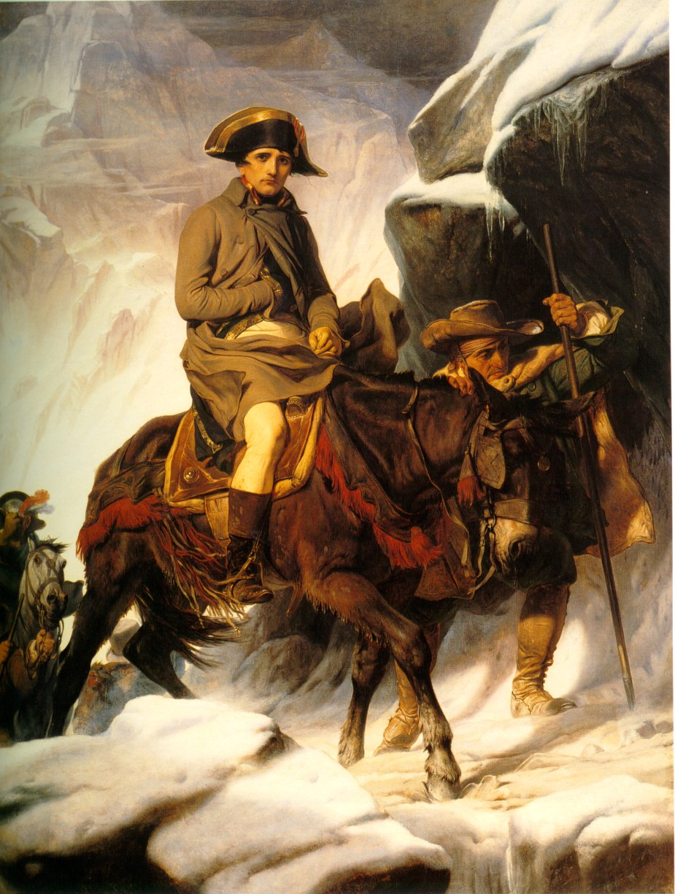
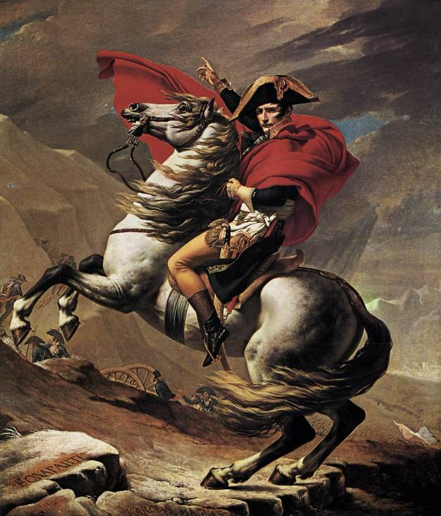

Slide 2
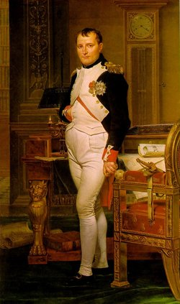
The Rise of Napoleon Bonaparte
1799-1815

Slide 3
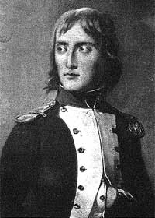
Napoleon’s character
Intelligent
Witty
Charming
Depressive
Childish
Decisive

Slide 4
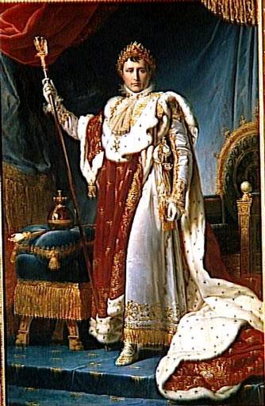

Slide 5
Life Under the Directory
Directory was corrupt, economy was poor
Following Robespierre, people went wild
Populace tires of revolution, war, high taxes, high prices, new constitutions, and directors!
People begin to look for strong leadership
War in 1795:
  Prussia accepts French annexation of Rhineland, the Austrian Netherlands, “Batavian Republic”
  War compounds political/social instability
  5 October 1795: Bonaparte puts down Royalist uprising
18th Fructidor 1797: Coup d’Etat

Slide 6
Napoleon’s early days
Born in Corsica (1769)—Family supports Paoli
Military school in France
Commissioned in artillery
Supports Revolution:
  Curtail abuses of Old Regime
  End Corsica’s status of conquered territory
  Opportunity for promotion
Helps take royalist Toulon in 1793
Age 24: brigadier general
1795: Suppresses revolt in Paris
1796: Commander of Army of Italy (Josephine) - Sweeps through Italy
Treaty of Campo Formio (17 Oct 1797)
  Austrians recognize Rhineland, Austrian Netherlands, Cisalpine Republic

Slide 7
Egyptian Campaign
Director Barras wants to harness Napoleon’s popularity
1798-1799: Sets off on Egyptian Campaign
Purpose: Attack British route to India
  “Civilizing mission” – Scientific
Battle of the pyramids (1798)
Battle of the Nile (1 August 1798)
Second Coalition (1799-1802)
  Britain, Russia, Austria
  Pope sent into exile
  French losses in Italy, Switzerland
  Irish revolt—French send troops, fleet defeated
  Russians withdraw in late 1799 – British naval rights
1799: Napoleon flees to Paris

Slide 8
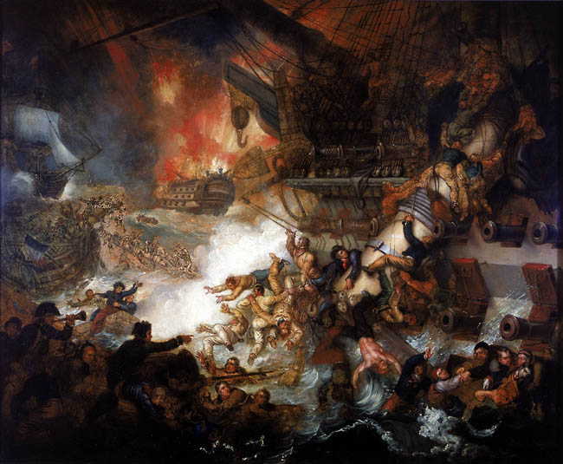

Slide 9
Consulate
Abbe Sieyes wants stronger executive
  Organized, through Talleyrand, a coup
18th Brumaire1799: Napoleon overthrows Directory (coup d’etat)—Napoleon only 30
Fake plebiscite: 99 % approval; “authority from above, confidence from below”
Constitution of 1799
  Universal suffrage, but reflects authoritarianism
  Brings stability
Serves as First Consul
  Quickly takes dictatorial powers
  Presents self as continuing Revolution
1802: Consul for Life

Slide 10
Concordat of 1801
Pius VII seeking to end turmoil
Napoleon’s aim: Detach Church from monarchist cause
Catholicism “religion of the majority of the people”
Pope appoints bishops, but on Nap.’s recommendation
Abandons new calendar
Organic Articles:
  Church under state administration
  Napoleon must approve all papal bulls
Church gains freedom of religious practice, but at the expense of independence
Protestants and Jews get freedom to practice religion
Alienates some on left, but very popular with the masses

Slide 11
Victories
Austria defeated, Russia tied up in war with Ottomans
Peace of Amiens (1802):
  Britain returns all French colonies
  Recognizes France’s conquests
Begins to dismember HRE
  Absorbs left bank of Rhine
  Pays off Prussia & Austria with small German states
Napoleon president of Cisalpine Republic
Helvetic Republic

Slide 12
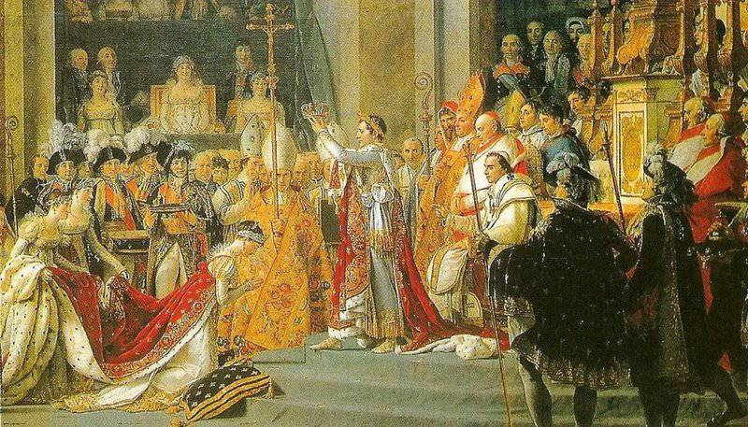

Slide 13
Emperor
1802: Declares self Consul for Life (plebiscite)
Duke d’Enghien tried and executed for conspiracy
Tribunate, Senate, and plebiscite approve changing from Consulate to Empire
Napoleon crowns self as Emperor on 2 December 1804
“The government of the republic is entrusted to an emperor”

Slide 14
Civil Code of 1804
(Napoleonic code)
Most lasting legacy of Napoleon
Single legal system
Equality under law
Makes property rights sacrosanct
Choose profession
Religious tolerance
End to serfdom/feudalism
“Free” public education
Basis for modern laws

Slide 15
Civil Code and Women
Reflects traditional attitudes toward family and women – “Social order”
Reaffirms patriarchal nature of family
  Women & children legally dependent on husband
  Women need husbands’ permission to buy/sell property – income pass to his descendants
  More about cattle than women
  Risk more severe penalties for adultery
  Could jail offspring
  Ends primogeniture
  Authority over marriage

Slide 16
Changes in society and government
Centralized administration
Meritocracy
  Creates new social hierarchy based on merit
    3,600 titles
    Legion of Honor
  “My motto has always been a career open to talents”

Slide 17
Steps back…
Despotic rule:
  Shuts down most newspapers
  Censorship
  Secret police
  Militarism
  Legislature rubber stamp

Slide 18
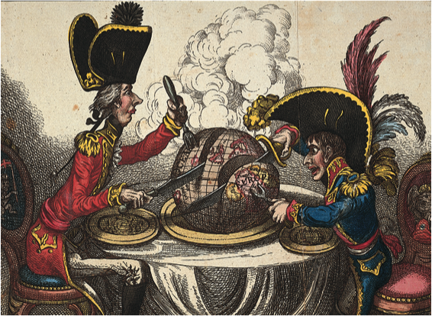

Slide 19
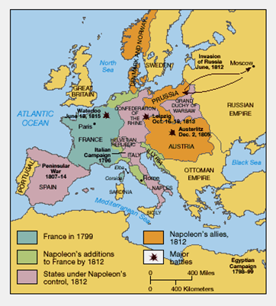

Slide 20
Victory and Empire (1803-1810):
Creates largest empire since Rome
  War & diplomacy rest on revolutionary tactics (artillery concentration, speed, pursuit), fervor & loyalty of soldiers, and weakness of unstable alliances of distrusting allies
  Divides & isolates enemies and defeats (militarily or diplomatically) one-by-one
  Defeats Austria (1801); Austria and Russia (1805); Prussia (1806); Prussia and Russia (1807)
  Only UK remains constant and undefeated

Slide 21
Rule under the Empire
Represents dual ideological and geopolitical threat – Combination of revolutionary ideals and traditional expansionism
By 1810, conquers all ruling families on continent
Vassal, dependent states ruled by Napoleon’s relatives (Spain (brother = king), Holland (annexed), Italy (Napoleon declares himself king), Westphalia (brother = king), and G.D. of Warsaw)
Many revolutionary ideals, civil code spread
Nobility, clergy lose privileges
Equal opportunity, religious toleration, equality before law

Slide 22
Wars: 1803-1805
War resumes with Britain in 1803
War vs. Third Coalition (UK, Russia, Austria, Sweden)
  Pitt the Younger leads coalition
  Crushing defeat for Russia & Austria at Austerlitz (two emperors defeated)
  Peace of Pressburg (Bratislava) Dec 1805 reduces Austria
Emperor Francis I dissolves HRE after c. 750-800 years of existence

Slide 23
Nemesis: The British
Defeated states forced against Britain
Britain survives because of sea power
Battle of Trafalgar (21 Oct 1805)
Continental System (1806): Shut Britain off from European trade

Slide 24
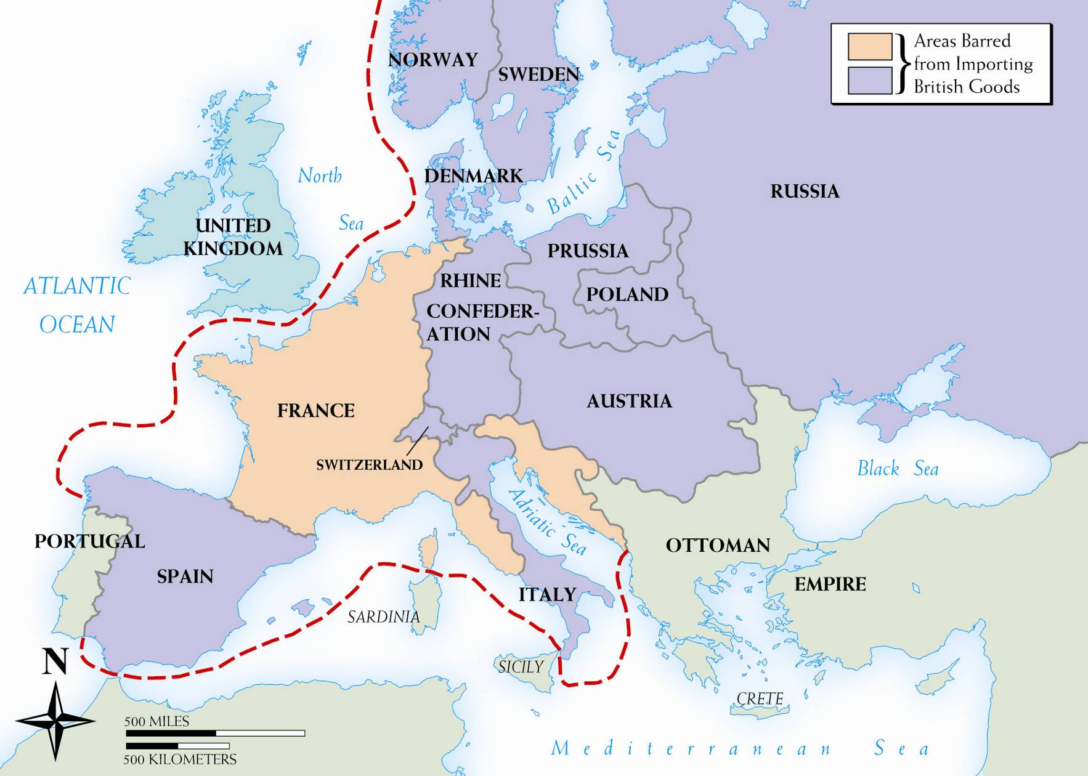

Slide 25
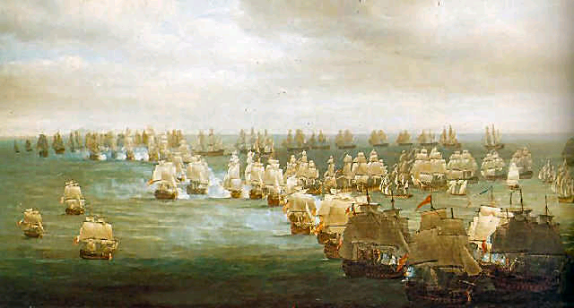
Trafalgar

Slide 26
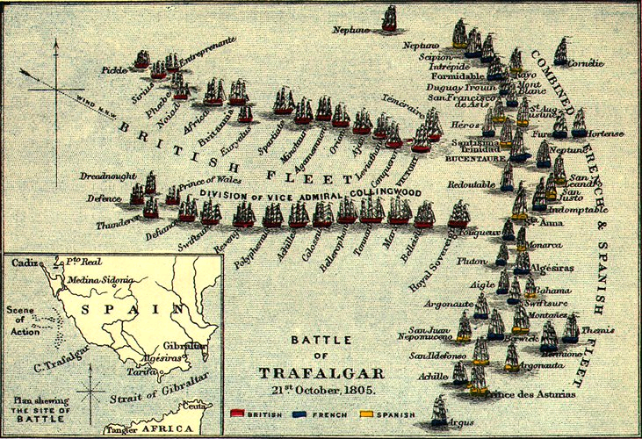

Slide 27
Wars: 1806-1807
War of the Fourth Coalition (1806-1807)
  Ill-timed Prussian entry
  Prussia crushed at Battles of Jena and Auerstaet
    Outmatched
    Outmoded
  Germany further reorganized into Rhineland Confederation
Russia plunges against France
  Bloody battles, including Friedland
Treaty of Tilsit (June1807): Napoleon charms Alexander
  Alexander I (1777-1825) and Napoleon meet on a raft
  Prussia = May exist, but loses much territory
  Polish state will be established—eventually
  Russia to join France in Continental system and reorganization of “Orient”
Napoleon at height-38 & rules/directs all of Europe outside of UK, Spain, and Russia

Slide 28
War of the Fifth Coalition (1809)
Austria & UK go to war in spring 1809
  Quickly defeats Austria at Battle of Wagram and captures Vienna
  Treaty of Schoenbrunn (Oct 1809): Austria gives up territory and loses access to sea
Count Klemens von Metternich becomes Austrian foreign minister
  Knew Talleyrand
  Pursues policy of appeasing Napoleon
  Leads to marriage with Marie-Louise (1810) and eventual birth of sole heir: Napoleon II

Slide 29
Problems and Changes
Talleyrand resigns as Foreign Minister in 1807, secretly plays against Napoleon
Divorces Josephine in 1809
  “I want to marry a womb.”
Marries Marie-Louise Habsburg; Importance?
Resentment building in conquered territories
  Resent high taxes and conscription
  Resent French police state and censorship
  Resent French troops, language, culture

Slide 30
Fall of Napoleon
Two great mistakes:
  Russia
  Spain
Spain (Peninsular war):
  (1808-1814)
Russian invasion:
  Grande Armee
  Moscow

Slide 31
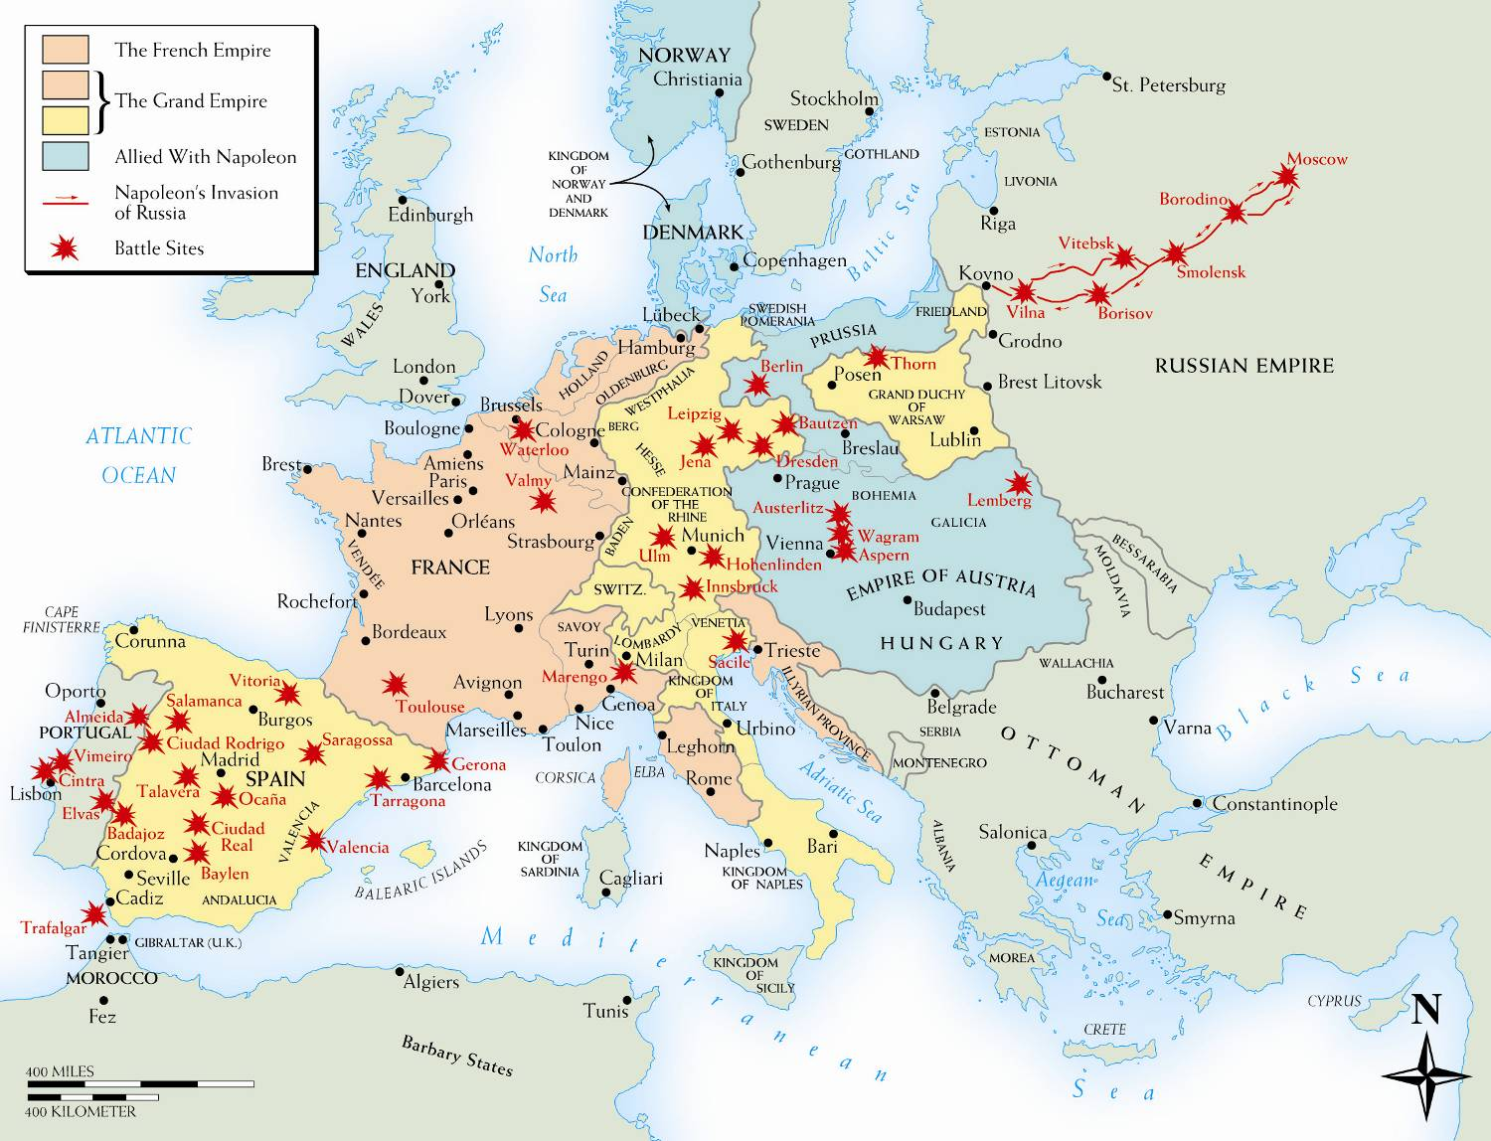

Slide 32
The Peninsular War (1807-1814)
France invades Portugal through Spain in 1807
Touches off nationalist revolt
  Spanish fight “little war”: guerillas
  Mutual atrocities
UK intervenes from 1808-1814
  Plays role as offshore balancer
Spain bleeds France slowly, but constantly, to the end

Slide 33
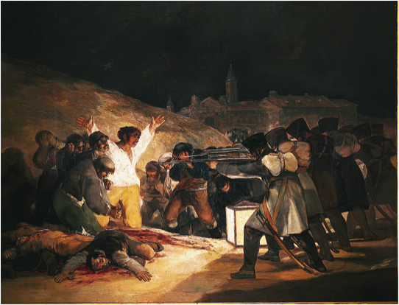

Slide 34
Prelude to Invasion
1807: Defeated Tsar Alexander I joins Continental System
Russia continues trade with Britain
June 1812: Napoleon invades Russia
  Like Charles XII and Hitler = Disaster

Slide 35
Grande Armée
450,000-600,000 men
Only half French
Ten corps vs. Russia’s two
Objectives:
  Bring “brother the Tsar” back into the fold
  Choke off Britain

Slide 36
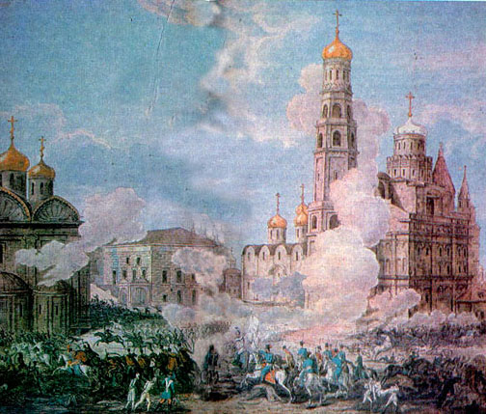

Slide 37
March on Moscow
Russians retreat
Napoleon dragged into endless Russia – Thousands of casualties
“Scorched earth”
  Russians avoid pitched battle
Battle of Borodino
Moscow captured
  Napoleon waits five weeks
  Tsar counts on “General Winter”

Slide 38
Generals Famine and Winter
Two-month retreat
Fewer than 20,000 of original 600,000 return
Napoleon rushes to Paris
Napoleon on defensive against Austria, Prussia, Sweden, and Russia

Slide 39
Fall of Napoleon & Rise Again
Napoleon's aura shattered
Metternich tried to negotiate at Dresden
  Napoleon rejects
  Austria joins allies
Spring of 1813, Napoleon defeated at Leipzig (“Battle of Nations”) by Russian, Austrian, and Prussian forces
Also in 1813, British and Spanish cross into France
Paris captured March 1814
12 April 1814: Senate (summoned by Talleyrand) forces Napoleon to abdicate
Exile to Elba: “Emperor of Elba”
  Louis XVIII replaced on throne

Slide 40
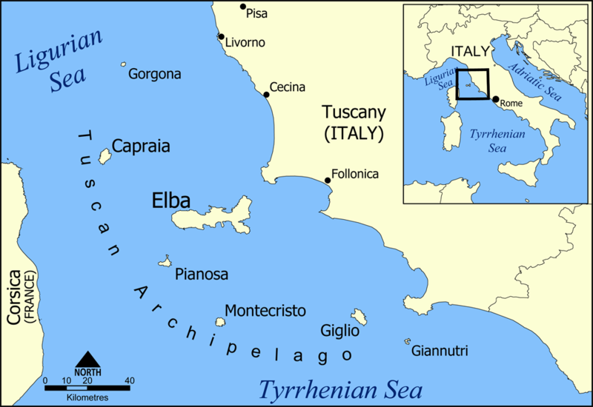

Slide 41
Return & 100 Days
26 February 1815, Napoleon escapes from Elba
  Rallies the Imperial army
  Returns to Paris
  Launches a campaign to split allied forces in Belgium
  Battle of Waterloo (18 June 1815)

Slide 42
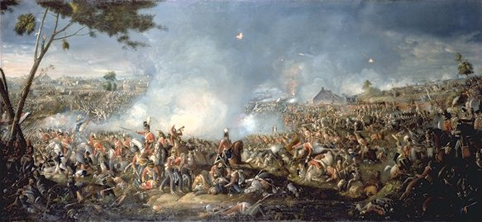
Waterloo & St. Helena
Launch Internet Explorer Browser

Slide 43
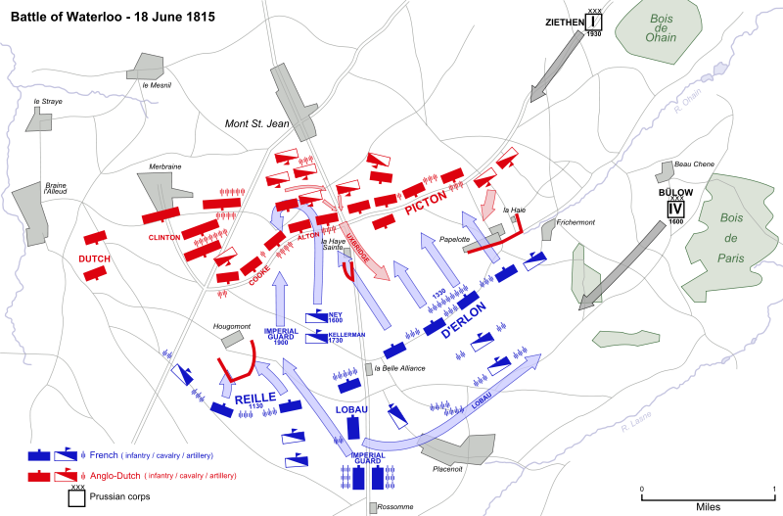

Slide 44
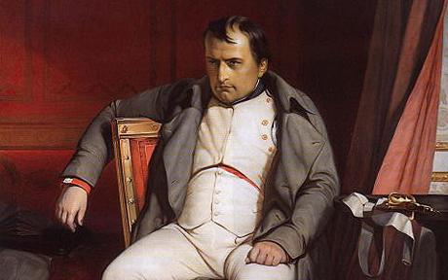
Final Exile and Legacy
Asks for retirement “near London” (!)
Shipped in exile to St. Helena
  Dies there in 1821
Forces of nationalism, ideology, and mass politics that he exploited would now continue

Slide 45
Napoleon’s Legacy
Positive
Negatives
“Every Frenchman could say during my reign,--”I shall be minister, grand officer, duke, count, baron, if I earn it—even king!”
Napoleonic Code: freedom, property, equality, religion
Careers open to talent
Eliminates serfdom
Nationalism = Secular religion
  Unintentionally in Germany, Spain, Italy, Poland
Reestablished slavery in Haiti
Merely replaced one king with his king
Dictatorship, censorship, police state
Guts Europe of treasures
Two million serve in Napoleon’s army
  90,000 die in battle; 3x as many
  600,000 as prisoners or “disappeared”

Slide 46
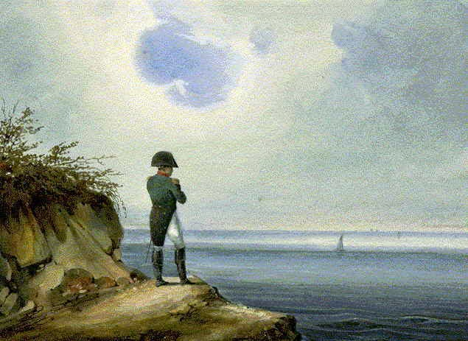

Slide 47
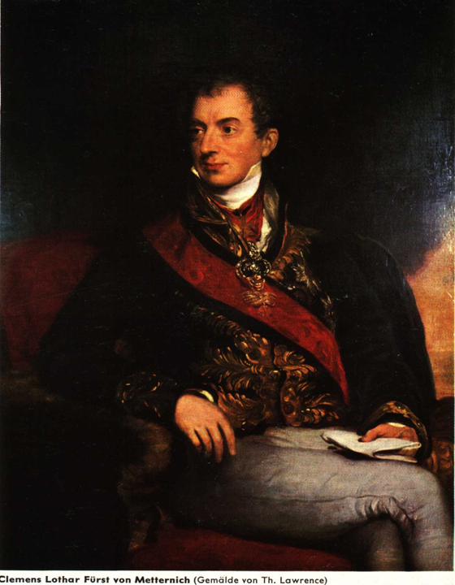

Slide 48
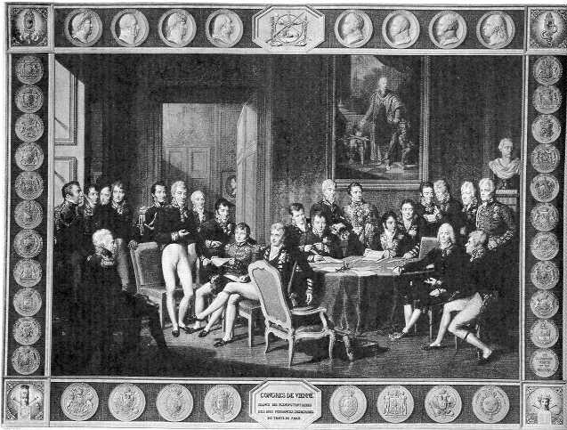

Slide 49
Congress of Vienna
Congress of Vienna (1814-15)
  Klemens von Metternich
Obsession: legitimacy
Balance of power
Conservatism: based on tradition & social stability
  Also government control

Slide 50
Objectives and Achievements of the Congress
Establish legitimacy of kings and the aristocratic social order
Roll back the liberalism and nationalism that arose under the French Revolution and Napoleon
Restore Bourbon monarchy (Louis XVIII)
Austria, Prussia, Russia form Holy Alliance, based on Christian principles, which England does not join
Quadruple Alliance reformed in 1815 to maintain peace in Europe
New Congress of Vienna remains intact for half a century and prevents general war for a hundred years

Slide 51
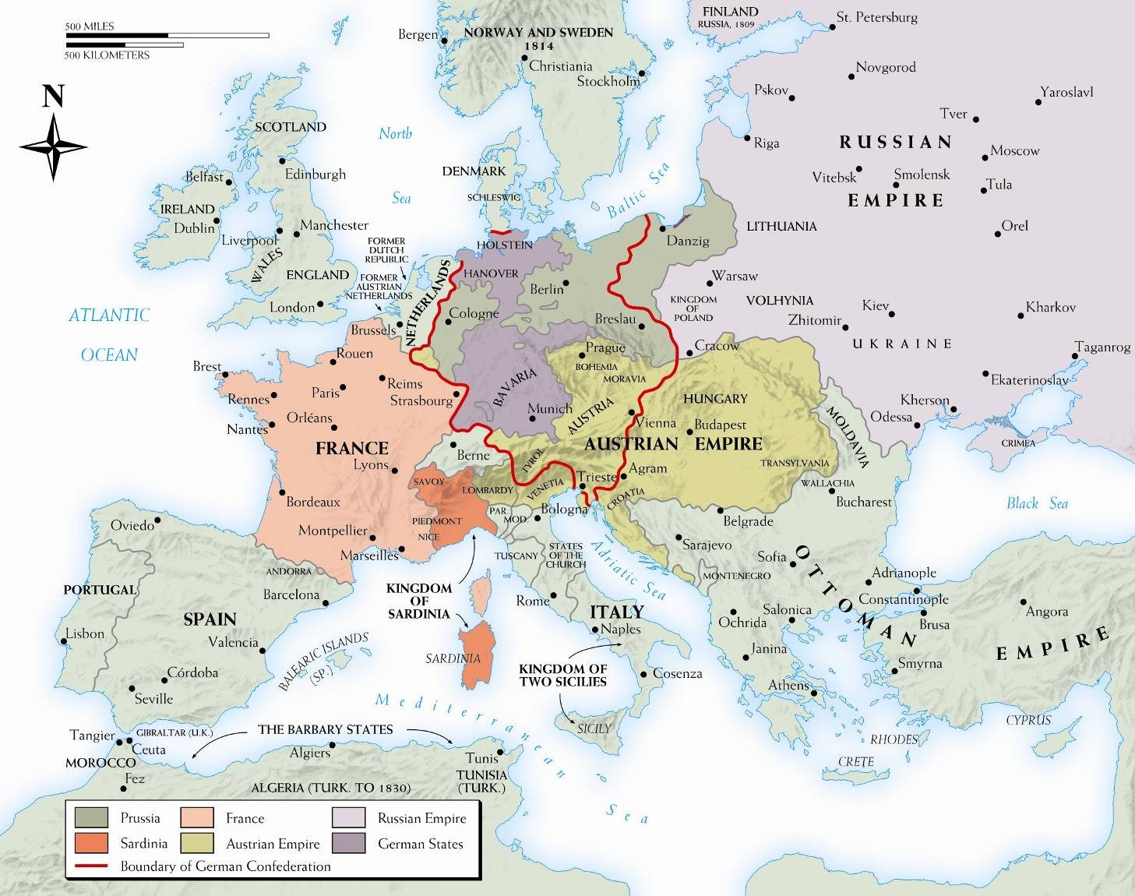
Notes:
Map 19–4 EUROPE 1815, AFTER THE CONGRESS OF VIENNA The Congress of Vienna achieved the post-Napoleonic territorial adjustments shown on the map. The most notable arrangements dealt with areas along France’s borders (the Netherlands, Prussia, Switzerland, and Piedmont) and in Poland and northern Italy.

Slide 52
The Romantic Movement
Romanticism – intellectual movement that was a reaction against the Enlightenment
Urged a revival of Christianity
Liked art, music, and literature of medieval times

Slide 53
Romantic Questioning of Reason
Rousseau and education – his work Emile (1762) – stressed the difference between children and adults
  Children should be raised with maximum freedom
  Adults should allow children to reason
Kant and reason – in his works The Critique of Pure Reason (1781) and The Critique of Practical Reason (1788)
  Sought rationalism of Enlightenment
  Humans have categorical imperative – an innate sense of moral duty or awareness

Slide 54
English Romantic Writers
Samuel Taylor Coleridge – wrote Gothic poems of the supernatural
William Wordsworth – wrote, sometimes with Coleridge, about how humans lose their childlike imagination as they get older
Lord Byron – rebel Romanticist, who wrote about personal liberty and mocked his own beliefs in famous works such as Don Juan (1819)

Slide 55
German Romantic Writers
Friedrich Schlegel – Progressive who attacked prejudices against women in novels such as Lucinde (1799)
Johann Wolfgang von Goethe – writings were part Romantic mode / part criticism of Romantic excess
  Faust – Part I – (1808) – long dramatic poem about man who makes a pact with the devil
  Faust – Part II – (1832) – taken through many mythological adventures, man dedicates his life to humankind

Slide 56
Romantic Art
Neo-Gothicism
  Supported the church and saw liberalism as evil
  Style of art seen in architecture and paintings
Nature
  Sublime – subjects from nature arouse strong emotions and raise questions about how much we control our lives
  Famous naturalists include Caspar David Friedrich and Joseph Malord William Turner

Slide 57
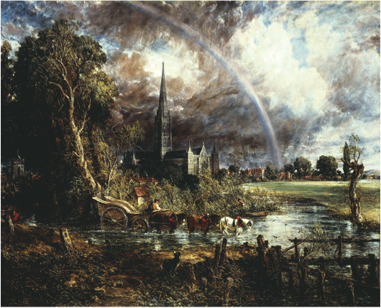
Notes:
John Constable’s Salisbury Cathedral from the Meadows displays the appeal of Romantic art to both medieval monuments and the sublime power of nature.
John Constable (1776–1837), “Salisbury Cathedral from the Meadows,” 1831. Oil on canvas, 151.8

Slide 58
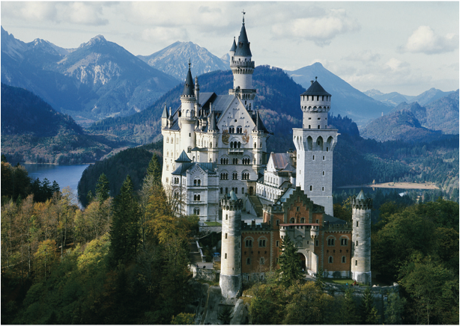
Notes:
At the castle of Neuschwanstein King Ludwig II of Bavaria erected the most extensive neo-gothic monument of central Europe.
Josaf Beck/Getty Images, Inc.–Taxi

Slide 59
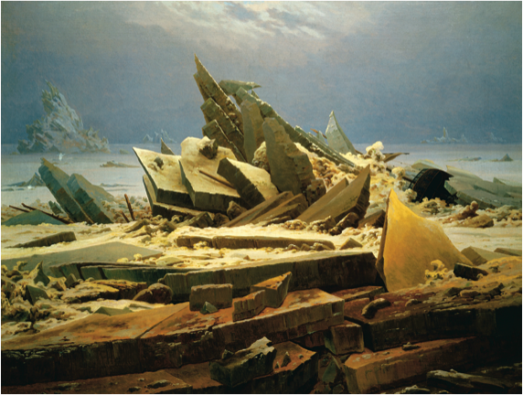
Notes:
Caspar David Friedrich’s The Polar Sea illustrated the power of nature to diminish the creations of humankind as seen in the wrecked ship on the right of the painting.
Kunsthalle, Hamburg, Germany/A.K.G., Berlin/SuperStock

Slide 60
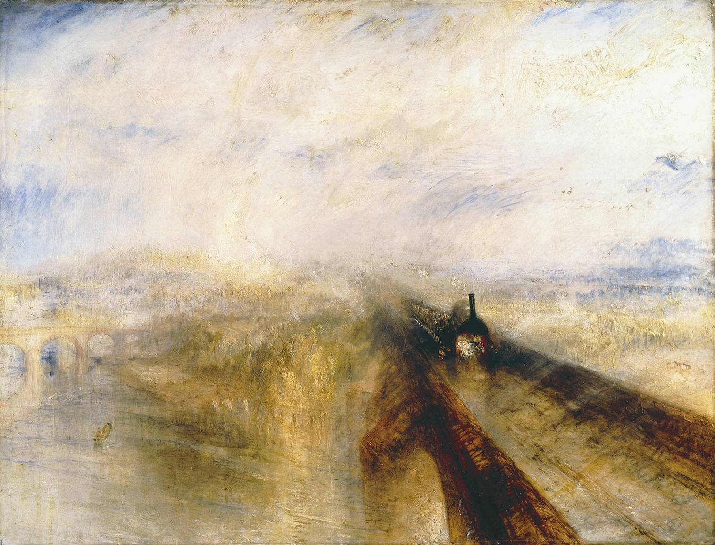
Notes:
Joseph Mallord William Turner’s Rain, Steam, and Speed—The Great Western Railway captured the tensions many Europeans felt between their natural environment and the new technology of the industrial age.
Joseph Mallord William Turner, 1775–1851, “Rain, Steam, and Speed—The Great Western Railway 1844”. Oil on canvas, 90.8 × 121.9. © The National Gallery, London

Slide 61
Romantic Religion
Methodism – revolt against deism and rationalism, stressed inward, heartfelt religion / its leader was John Wesley
Continental Religion – religious developments based on feeling
  Chateaubriand – The Genius of Christianity (1802) – essence if religion is passion / foundation of faith is emotion
  Scleiermacher – Speeches on Religion on its Cultured Despisers (1799) – religion as an intuition or feeling of absolute dependence on an infinite reality

Slide 62
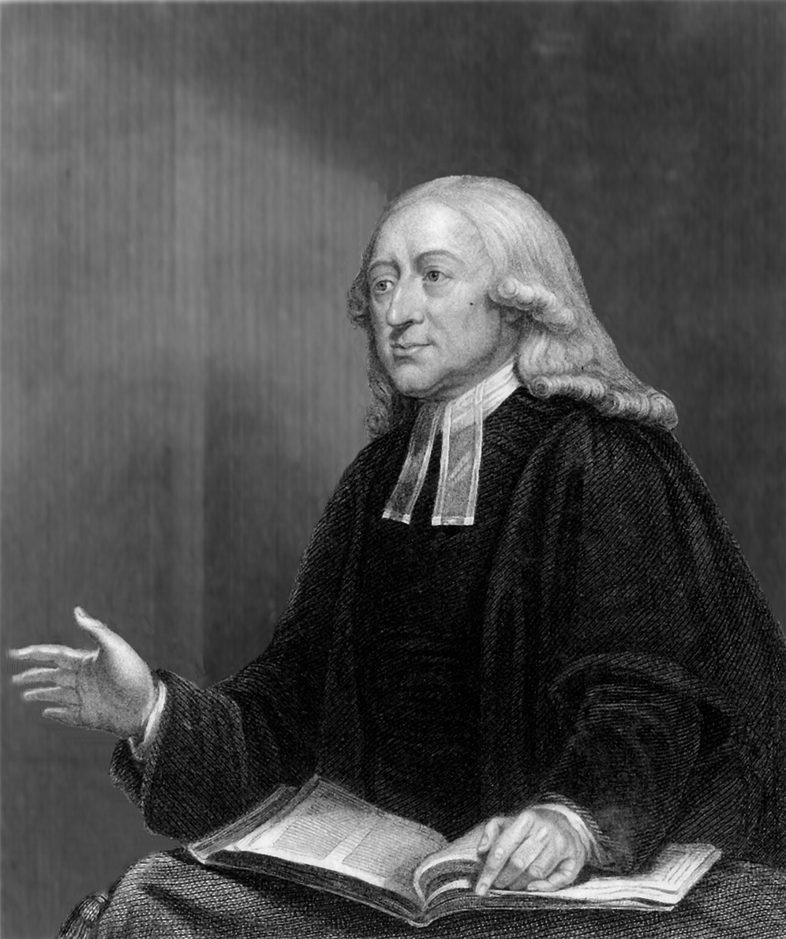
Notes:
John Wesley (1703–1791) was the founder of Methodism. He emphasized the role of emotional experience in Christian conversion.
CORBIS/Bettmann

Slide 63
Romantic Views of Nationalism and History
Johann Gottfried Herder – German Romantic
  Critic of European colonialism
  Human beings develop organically
  The Grimm Brothers, famous fairy tale writers, were his followers
Georg Wilhelm Friedrich Hegel – German Romantic philosopher
  Believed a predominant set of ideas, thesis, are at odds with another set of ideas, antithesis – the patterns clash, resulting in a new synthesis emerges as the new thesis in a viscous cycle
  All cultures valuable because they are all part of this clash

Slide 64
Islam and Romanticism
Islam seen in a more positive light than during the Enlightenment
Under Napoleon, learning about Islam became an important part of French intellectual life
Rosetta Stone – found on one of Napoleon’s expeditions became the key to unlocking Egyptian hieroglyphics

Slide 65
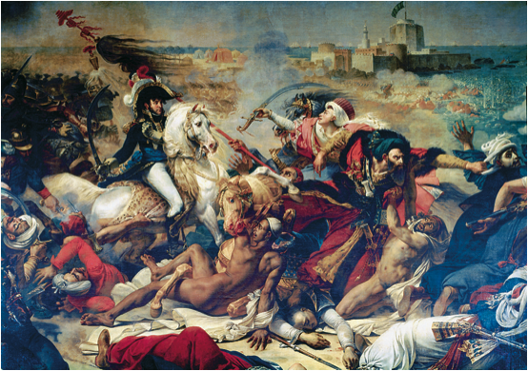
Notes:
When Napoleon invaded Egypt in 1799, he met stiff resistance. On July 25, however, the French won a decisive victory. This painting of that battle by Baron Antoine Gros (1771–1835) emphasizes French heroism and Muslim defeat. Such an outlook was typical of European views of Arabs and the Islamic world.
Antoine Jean Gros (1771–1835). Detail, “Battle of Aboukir, July 25, 1799,” c. 1806. Oil on canvas. Chateau de Versailles et de Trianon, Versailles, France. Bridgeman–Giraudon/Art Resource, NY

