Slide 1
The Industrial Revolution
You had a good run, environment. Sorry about all the coal.

Slide 2
Overview
Credit & Banking Expand
Dramatic Improvements in Transport
  Rail
  Steamships
  Roads
Rising Agricultural Productivity
Rapid Urbanization
Increased Demand for Manufactured Goods
Mechanized, Factory Production
  Rural Production Down, Marginalization of Artisans
Appalling Urban Conditions
Lurid Accounts
Calls for State-Sponsored Reform
Skilled Workers Protest Harsh Conditions
  Prolitarianization
  Socialism

Slide 3
Background to Transformation
Intensification of existing forms of production
  Traditional organization
  Major changes only in mid-19th century
Demographic explosion
Disease and famine
  Cholera
  Potato famine (1840s)
  Tuberculosis

Slide 4
Why Declining Death Rate?
Smallpox vaccinations
Greater attention to hygiene
Cleaner water – Sand filters, iron pipes, reservoirs
Increased life expectancy among all classes
Lower infant mortality
  Safer water supply
  Better waste disposal
  Decline of wet nursing
  Fresh/sterilized milk
Declining birth rates
Period of relative peace

Slide 5
Expanding Agricultural Base
Sustained population growth
Market-oriented farming supports accumulation of capital
More land under cultivation
Yields increase: England 3x grain
  Less fallow land
  Fertilizers and intensive techniques
Continent- Not as much consolidation
  France: N=Rotation, larger plots; S=Small division-wine
  Germany: Production 2x population growth
  Balkans and Russia
    Subsistence farming
    Serfdom cripples growth

Slide 6
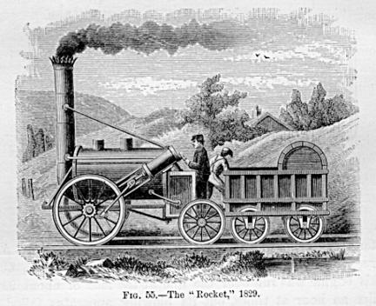

Slide 7
Trains
1820: First to haul coal in N. England
1830: Passenger train between Liverpool and Manchester
Expansion
  100 miles of rail in 1832; 6600 in 1852
  200,000 employed; Landscape transformed
Catalyst for investment
  Middle class investors
  Spurs metallurgy
Revolutionary effects
  Shipping costs reduced by 2/3rds
  Increased consumption, production
  Fresh milk, frozen meat
  Displaced population
  State role
    France=Semi-public
    Austria, Belgium= state control
  Ties places, people together
    Mail
    Travel
    “Speeds up time”
  Environmental costs

Slide 8
Steamships and Roads
1816: Liverpool to Boston in 17 days (1/2 time)
1830s-40s: River travel
Canals
Improved roads

Slide 9
Society in the Industrial Revolution
Changes and challenges

Slide 10
Continuities on the Land
Agricultural improvements, end of serfdom lead to movement to cities
Unrest against landowners in 1830s and 1840s
Rural poverty severe
  Share tiny homes with animals
  Often windowless
Serfdom exists in Austria until 1848, Russia until 1861
Diets extremely poor
  Rye bread, porridge, potatoes (north); cabbage (central and east), onions and garlic (France)
  Wine in south; beer or cider in north
Emigration to North America in 1830s-40s
  Irish (Potato famine)
  German states

Slide 11
Urbanization
By 1850:
  Britain, ½ population urbanized
  France, only 1/4 live in towns larger than 2,000
  London grows from 900,ooo to 2,300,000
  Paris 550,000 to 1,000,000
Farther east, towns fewer and smaller
Problems with sewage, housing, pollution, crime (6x)
Better transportation=suburbs
  Middle classes withdraw into elite districts or, in England, to posh suburbs
Increased social segregation; visibility of differences in classes
Cities populated by migrants from the country

Slide 12
Women in the Workforce
Domestic service:
  40% of women in workforce
  Higher literacy
  Better social mobility
Country women:
  Spinning, weaving (cottage industry)
  Work in fields
Urban women:
  Laundresses
  Seamstresses
  Street merchants
  Prostitutes
Industry:
  Work in factories, especially textiles
  Relatively small part of workforce
  Male workers resent
Low-skilled labor = low pay

Slide 13
Women and Families
Working women=Less dependent on parents
  Marry earlier
Marriage still economic relationship
  Increase in out-of-wedlock births
Factories = Separation of home and work
  Many mothers leave to care for children
Prostitution
  Governments register, regulate
  Middle-class sees as moral failure
Movement toward men working, women remaining home

Slide 14
Child Labor
Children always worked in agriculture
Small size, cheapness=highly employable
1830s: 1/3 of workforce
Sometimes entire families in factories
  Fathers supervise
Work often dangerous
Child labor laws
  Britain in 1832
  France in 1841

Slide 15
Laboring Poor
Industrialization increases employment
High wages for male skilled workers
Cheaper goods=Higher incomes
British workers better off than others
  Paternalism
  Poor Laws
Poor working conditions
Artisan incomes, employment fall
Gap between rich and poor increases
Housing miserable
Class consciousness
  “proletarianization”
  Artisans first to demonstrate
    Over-supply
  Luddites

Slide 16
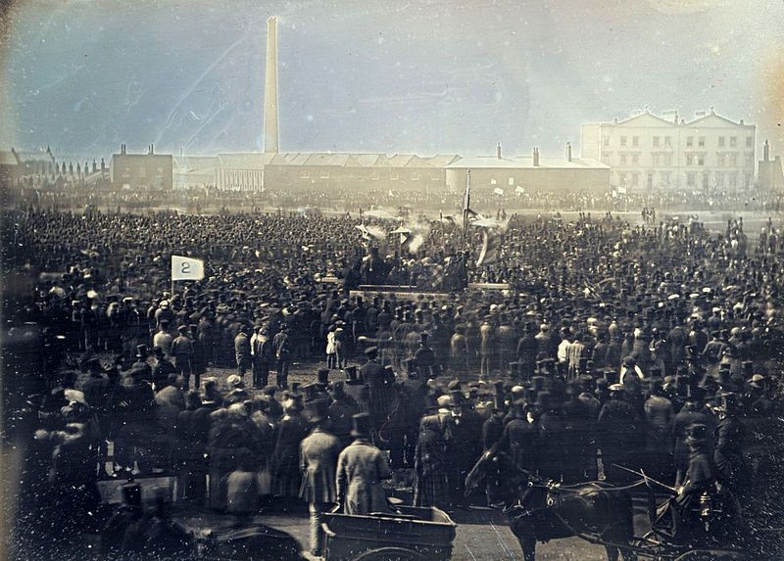

Slide 17
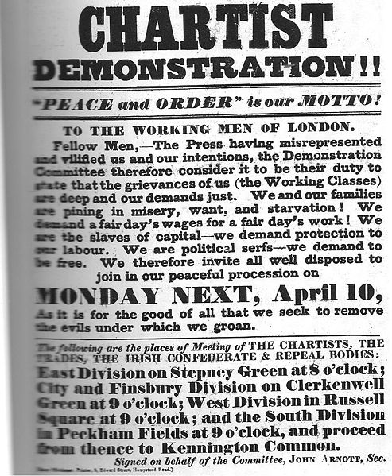

Slide 18
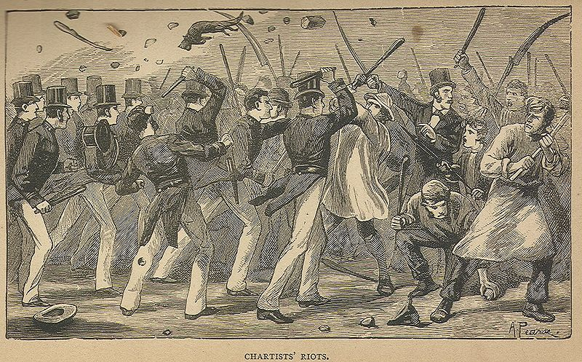

Slide 19
Chartism
Wm. Lovett founds “London Workingmen’s Association…”
Great Charter
  Democratization
  Universal Male Suffrage
  Annual Elections
  Secret Ballots
  Equal electoral districts
Object to monopoly of wealth and political influences
Divided between peaceful “moral force” and violent “physical force” groups
1839: Parliament rejects Chartist petition (1.3 mil)
1842: Parliament rejects another signed by 3.3 mil.
Stop

Slide 20
Economics of the Early 19th Century
Liberalism v. socialism: The eternal battle begins

Slide 21
Classical Liberalism
Begins with on Adam Smith, Wealth of Nations
  Rational self-interest leads to best economic outcomes
  Liberalism based on individualism and individual freedom
  Favor economic growth through free enterprise
Laissez-faire:
  Government/other intervention usually interferes with the proper functioning of the economy, leading to poor outcomes
  Market solutions are usually the best solutions
  Recognize role for government in defense, preserving property rights, enforcing contracts
  Emphasize thrift, competition, hard work

Slide 22
Key Classical Liberals
Thomas Malthus
(1766-1834)
David Ricardo
(1772-1823)
Essay on the Principle of Population (1798)
Population will outstrip food supply
  Geometric v. arithmetic
  Late marriage, chastity only way to slow
Failed to recognize technological development
Principals of Political Economy (1817)
Comparative Advantage
  Proves that free trade always benefits both parties
“Iron Law of Wages”
  Wages will always return to subsistence level
  Higher wages=More children=larger labor force=lower wages

Slide 23
Classical Economics and Policy
France
Germany
July Monarchy encourages pursuit of wealth
Oversee construction of large capital projects
Absolutist tradition interferes with liberal economic growth
Zollverein (1834)
  Liberalized trade among all major German states outside of Austria

Slide 24
Liberal Economics in Britain
Jeremy Bentham (1748-1832)
  Utilitarianism: All human activity should be based on the amount of happiness it provides
  Believed in government intervene on behalf the disadvantaged
  Governments can provide most happiness by providing most freedom
Two major steps:
  Poor Law (1834): Workhouses
  Repeal of the Corn Laws (1846)
    Landed interests fight
    Lower food prices = Higher wages
    Lower tariffs = Lower prices for British goods = Higher exports

Slide 25
Socialism
Socialists call for fundamental change in property ownership
  Urge end to private ownership of means of production. Perhaps distribution = state/corporate ownership.
  State ownership = Serve interests of all people
  People can learn to be cooperative, not competitive

Slide 26
Utopian Socialists
Robert Owen (1771-1858)
  New Lanark, Scotland (New Harmony, IN)
    Experimental Factories
    Good surroundings=Improved character
    Provided good quarters, recreation, education
    Most important, provides incentives
      Higher profits
Claude Henri de Saint-Simon (1760-1825)
  Focus of government should be on economic issues
  Technocracy directed economy
Charles Fourier (1772-1837)
  Urged self-sufficient socialist “phalanx” communities
  Individuals will do work they most enjoy and frequent job changes
  Fails
Anarchism:
  Also seeks end of private property and capitalism
  Also seeks destruction of the state itself

Slide 27
Marxism
Karl Marx (1818-1883)
  Radical German philosopher, journalist
  Moves to Paris in 1844, collaborates with Friedrich Engels (1820-1895)
    Engels had lived in Manchester (Conditions of the Working Class in England (1845)
Communist Manifesto (1848)
  “scientific socialism”—theory of revolutionary change
  Based on Hegelian historical dialectic
  Materialism and determinism
  Class struggle: Feudal to bourgeois to proletariat to dictatorship of the proletariat to the end of all classes
  Reorganize society, state control of means of production and distribution

Slide 28
1848
The Year of Revolutions

Slide 29
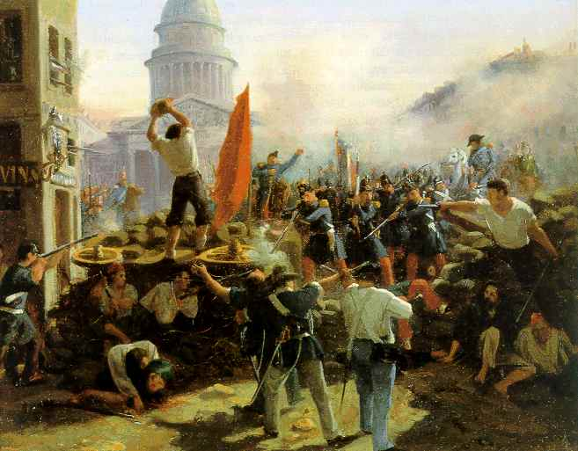

Slide 30
Background to Revolution
1837: Recession, wide-spread unemployment
1840s: “The Hungry Forties”
Revolution urban, middle-class, and liberal
Why France?
  French liberals alone in replacing monarchy with a republic
  French liberals embrace universal suffrage
    Elsewhere, liberals support property qualifications
Nationalism in Central Europe
  German, Austrian, Italian revolutions characterized by nationalism
  Germany & Italy: Seek Unification
  Austria: Seek break up and nationhood

Slide 31
The Revolution in France
Banquets protesting Louis-Philippe banned (Feb 1848)
  Increasingly arbitrary government
  Spontaneous riots
Second Republic proclaimed
  Provisional government
Socialists v. Moderates
  Louis Blanc placed in charge of establishing workshops for unemployed
  Radicals dominate Paris and cities, but country conservative
  Moderates dominate elections
  Workshops shut down
Suppression of June Days Revolt
  Workers revolt in protest in June 1848
  Provisional government crushes revolt
Constitution of the Second Republic
  Nov 1848
  Universal manhood suffrage
  Unicameral, presidential
Louis Napoleon Bonaparte (1803-1873)
  Won election as president
  Establishes dictatorship as Napoleon III

Slide 32
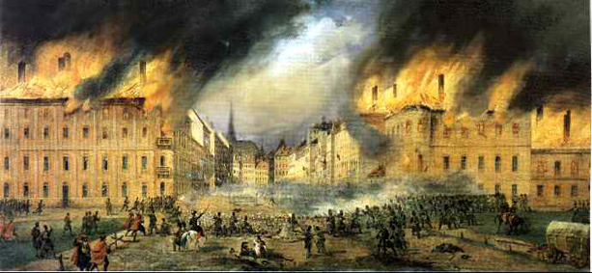

Slide 33
Revolutions in Austria
Ferdinand I ruled: Authority led by Metternich
Uprisings in Vienna in March
  Response to Paris
  Constituent assembly drafts constitution
    Abolished the Robot, ending peasants’ need for revolt
  Metternich falls in March 1848
  Government regains control
    Dec 1848: Swartzenberg arranges for Francis’ abdication, 18 year-old Franz-Joseph (r. 1848-1916) takes over, denies predecessor’s commitments
    Assembly asks for decentralization, Swartzenberg denies
    Franz Joseph suspends constitution, returns centralized rule

Slide 34
Revolt in Hungary and Bohemia
Hungary
Bohemia
Louis Kossuth demands self-government (Mar 1848)
March Laws establish elected parliament, abolish serfdom
  Austrian govt accepts
Austria moves against in 1849
  Kossuth declared independence
  Czar Nicholas sends 100,000 troops to help crush
Czechs revolt in Prague (Mar 1848)
  Austrians promise assembly
  Pan-Slav Congress calls for solidarity against Austria
  Austria crushes uprising in June

Slide 35
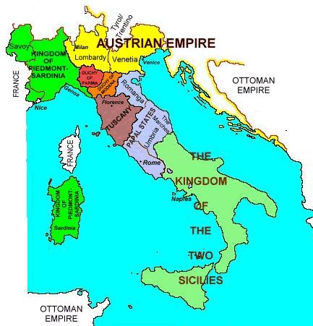

Slide 36
Revolutions in Italy
Revolts against Austria and princely rulers
  Revolts in the Two Sicilies (Bourbon), Piedmont-Sardinia (Savoy), Venice and Lombardy (Habsburg)
  Liberal constitutions granted in Sicilies and Piedmont
Suppression of Revolution
  Suppressed in Two Sicilies (May 1848)
  Austrians (Radetzky) defeat Piedmontese (July 1848), then restore control over Lombardy
  Feb 1849, Garibaldi, Mazzarini, other revolutionaries proclaim Roman Republic in Papal States
  Mar 1849, Austrians re-defeat Piedmontese
    Victor Emmanuel II replaces father as king
  Apr 1849, Louis Napoleon crushes republic in Papal States, take Rome in June
  Austrians crush revolution in Tuscany (May) and in Venice (Aug)

Slide 37
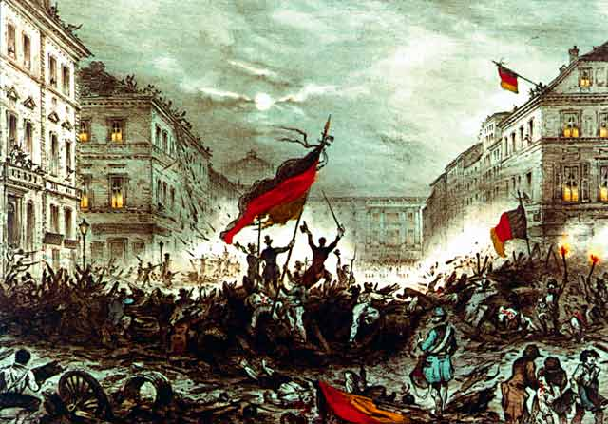

Slide 38
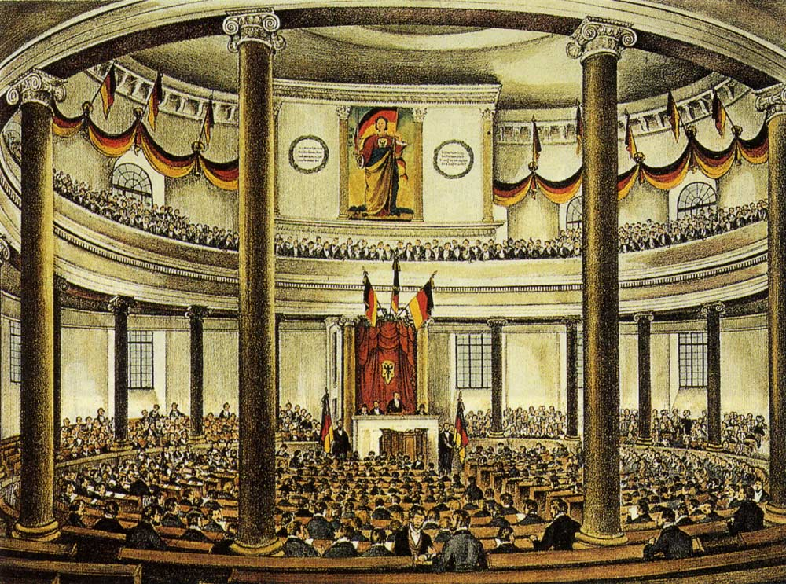

Slide 39
Revolution in Germany
German liberals call for reform and unification
March Days in Berlin
  Frederick IV (r. 1840-61) initiates some liberal reforms, ends censorship
  Announces assembly to draft Prussian constitution
    Meets from May-autumn
Elsewhere, preliminary assembly calls for national assembly

Slide 40
German National Assembly
Begins deliberations in Frankfurt in May 1848
  Elected by universal manhood suffrage
Gross- or Kleindeutschland?
  Include Austria and the Habsburgs, or not?
  Kleindeutschland wins out
    Emperor unlikely to allow a liberal constitution
    Empire is non-German

Slide 41
Collapse of Revolution
Prussian Constitution
  Frederick Wilhelm IV loses enthusiasm, begins to suppress revolution
  Dissolves Prussian constitutional assembly in Dec 1848
  King issues his own constitution
    Bicameral parliament
      Upper chamber: Junkers
      Lower house: Wealthiest 20% elect 2/3^{rds} of members
    King retains absolute veto, can rule by decree
“Humiliation of Olmütz”
    March 1849-National assembly completes constitution
      Offers crown to Frederick Wilhelm IV; he declines
    King tries to form a north German confederation
      Austria opposes, forces Prussia to give in Nov 1850

Slide 42
Summary
By 1850, conservative order restored
Remaining changes slight
  France: Arbitrary rule of Louis-Philippe Orleans replaced by that of Louis-Napoleon Bonaparte
  Austria: Franz-Joseph replaces mentally-incompetent Ferdinand I, centralized Austrian rule re-established
    Robot, serfdom abolished
  Italy: Austrians, French help to overthrow revolution
    Piedmont-Sardinia retains liberal constitution
Liberal constitutionalists universally defeated
  Ideas live on: Italy unifies in 1860s, Hungary gains self-government in 1867; Germany united by 1871

