Slide 1
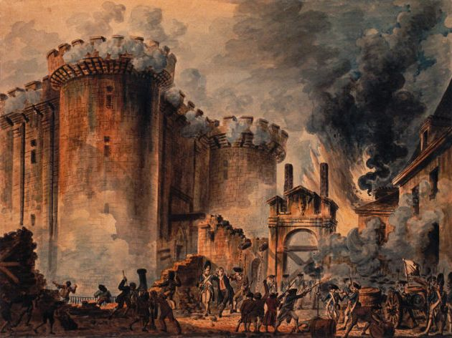
The French Revolution
The French Revolution
The Beginning of the End for Western Civilization…

Slide 2


Slide 3
Objectives
Analyze the social, political, economic, religious, and intellectual causes and results of the French Revolution.
Compare the political, economic, religious, and intellectual causes and results of French Revolution with other major revolutions around the world.

Slide 4
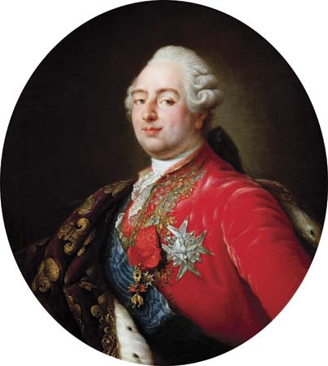

Slide 5
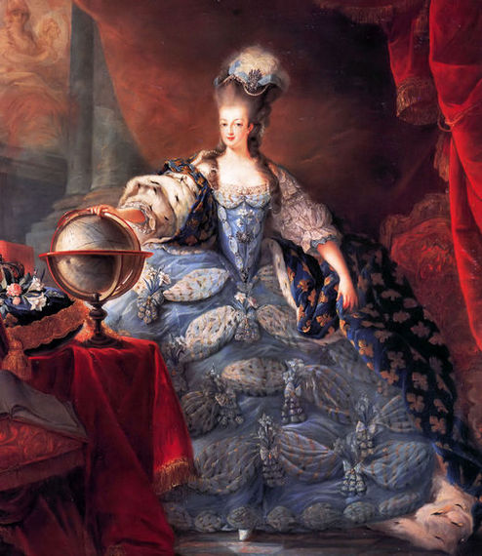

Slide 6
Three Estates of French Society
First: Clergy
  0.5% of population
  10% land ownership
  Exempt from taille (taxes levied by the king)
Second: Nobility
  1.5% of population
  25% of land ownership
  Exempt from taxation
Third: Commoners
  98.5% of population
  65% of land ownership
  Pay all taxes
  Bourgeoisie
    8% of pop.

Slide 7
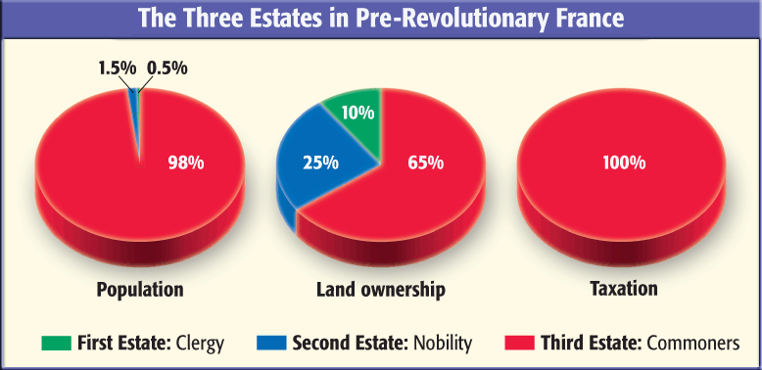

Slide 8
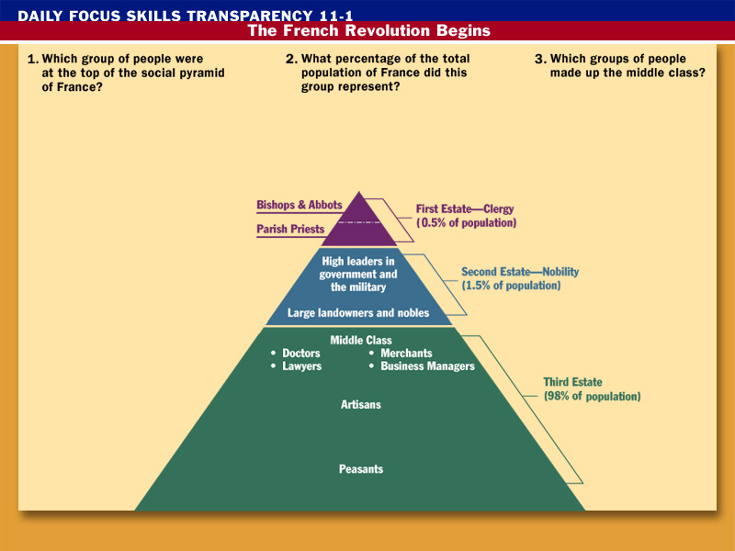



Doctors, lawyers, merchants, and business managers made up the middle class.
Clergy: bishops, abbots, and parish priests are at the top of the social pyramid.
This group represented .5% of the total population.
Click the mouse button or press the
Space Bar to display the answers.

Slide 9

Economic Crises
French treasury broke
  At war for more than a century
  French treasury fails to find alternative revenues
  Tax reform critical
    Only peasants and middling orders pay
    First and Second Estates resist
    Parlements reject in 1748 and 1768

Slide 10
Aristocracy
Tax reforms threat to aristocracy
Economic base in decline
  Tradition=No business
Resents bourgeoisie
Return to old feudal
dues & obligations, monopoly on top gov’t & military positions
Alienation from monarchy

Slide 11
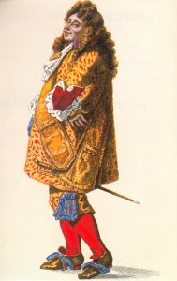
Middle Classes
5x increase in commerce =
  Vast wealth
Buy offices and titles from
King, but this slows
Wealthiest avoid taxes
Angered by “feudal reaction”, political gap
Lower middle classes: Growing wealth gap, rising prices

Slide 12
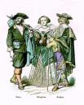
Peasantry
Most liberated on continent (40% of land ownership), however:
  Bad harvest=poverty
  Tithes & rents
  Increasing taxes (taille)
  Resentment of hunting/
  fishing rights
  Population growth on
  rural land=pressure
  No political voice

Slide 13
Setting the stage
1787-1789: Bad harvests
  Starvation of peasants, loss of income to sans-culottes
  Landlords raise grain prices and rents to maintain profit-margins
  Peasants cannot pay taille
  Parlements protest religion and high taxes
    Louis abolishes them in May 1788
  Financial crisis reaches boiling point in Aug 1788
    Law & order breaks down
    People demand meeting of Estates General

Slide 14
Estates General
American rebellion = Need to restructure tax system – ½ of all gov’t revenue to pay
  Parlements’ Arguments: Treads on rights of the “people”
Louis XVI reluctantly recalls Estates General (first since 1614)
  Louis grants very broad franchise
  Third Estate dominated by radical lawyers & professionals
    Demand vote by head, or double vote
    Flood France with pamphlets
  The three united in opposition to Louis’ “inadequate” reform efforts
  Third demands equal representation
    King locks doors, they walk (17 June 1789)

Slide 15
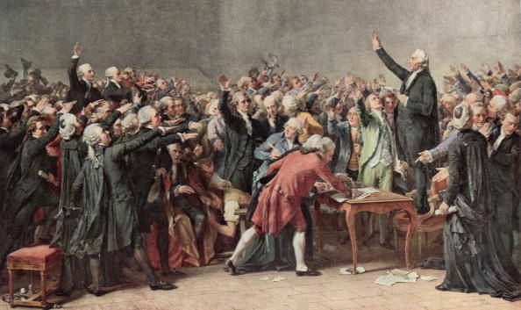
The Tennis Court Oath

Slide 16
National Assembly and
Tennis Court Oath
King will not rule on vote in Estates
Third Estate invites others to join in National Assembly - Some from 1st and 2nd do so
National Assembly locked out of meeting place
“Tennis Court Oath”
  June 17, 1789
  Swear not to leave until France has new constitution
  Third Estate Declare that Third Estate represents the nation
    Hence, it was the National Assembly of France
  Louis capitulates
    Three estates to draft new national constitution

Slide 18
Storming of the Bastille
King prepares force against National Assembly
Mob storms the Bastille, 14 July 1789-Only seven prisoners freed
National Guard established in Paris against Louis
Great Fear in rural France
  Summer 1789
  Burn artistos’ property
  Form militias

Slide 19
A Social Revolution
National Assembly-4 August 1789
  Establishes constitutional monarchy & drafts constitution
  Abolishes aristocratic financial privileges & landlords’ rights
  Aristos & clergy renounce position & advantages (taxes, tithes, etc.)

Slide 20
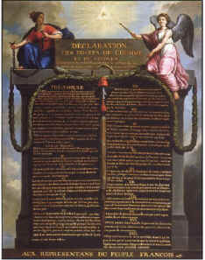
Declaration of the Rights of Man & the Citizen
26 Aug 1789
(read)

Slide 21
Declaration of the Rights of Man
Summary of Enlightenment thought on the state
Nothing about rights of women
  Olympe de Gouge: Declaration of the Rights of Women (1791)
Nothing about inequality of wealth
Nothing about balance of rights between individual & state

Slide 22
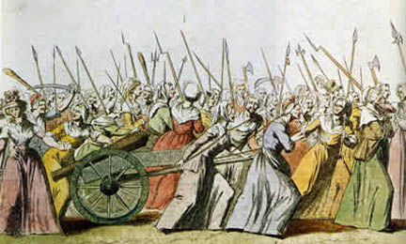
Fishwives Take Versailles: 5 Oct 1789
Marie encourages King to reject Declaration—He hesitates
Women march on Versailles
Demand food, rights
Royal family forced to Paris-Guards’ heads on pikes
Held virtual prisoners in Tuilleries
Church taken over
  Lands
  State employees

Slide 23
Constitution of 1791
Establishes moderate constitutional monarchy
King merely first officer of state
  Controls military & foreign policy
  Two year suspensive veto
Indirect elections: franchise to 1/6 of people (male property owners over 25) – Widest in Europe
Legislature may override King’s veto
Administration rationalized: 83 department
Abolition of privilege; equality of all
  Guilds & monopolies eliminated
Church “federalized”
  Lands confiscated
  Clergy become civil servants
  Priests elected & need not be Catholic
No one satisfied

Slide 24
Problems
Priests, nobles, lower classes, political radicals resist the new government. Why?
Flight to Varennes
  Louis and family try to flee in June 1791 to Austria.
  Recognized, captured, returned to Paris.
Legislative assembly meets for first time in October 1791.

Slide 25
Austria and Prussia Intervene
Declaration of Pillnitz
  Austria and then Prussia urge European monarchies to band together to restore Louis
  Britain, Spain, & Russia join
Assembly declares war in Spring 1792
French initially do badly

Slide 26
The Terror Begins
Defeats in war, economic shortages, resistance of Church = demonstrations
Jacobins form the Paris Commune
  Capture king, demand republic
  Sans culottes
Minister of Justice Georges Danton hunts, kills opposition
Mobs storm prisons, kill/wound 1000 “enemies of France”
21 September 1792: Monarchy abolished. Republic founded.

Slide 27
Committee on Public Safety
Dominated by Robespierre and the Jacobins
Army reforms
  Levée en Masse
    National Emergency=Universal Conscription
    1.2 million men under arms
  Promotion on merit, purge of aristos
Conquer Austrian Netherlands
  Spreading war beyond France’s borders
People’s wars=Nationalism

Slide 28
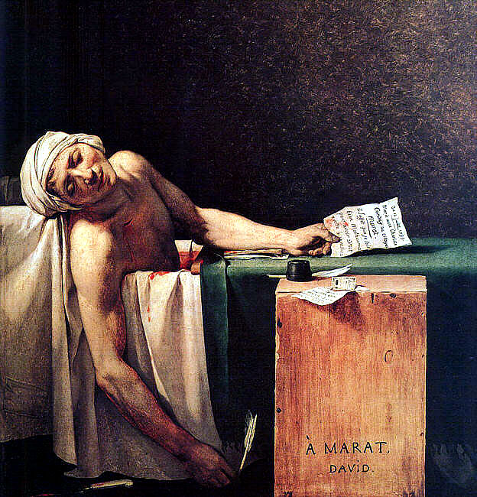

Slide 29
Wither Louis XVI?
Jean-Paul Marat: Publishes Friend of the People
  Poor have right to take from rich
  King should be killed
  Later: Kill, kill, and kill!
  Murdered in fall of 1793
Factions in Jacobins:
  Mountain: Urban radicals – Kill king
  Girondins: Rural moderates – Work with king
  The Plain: Between the two extremes

Slide 30
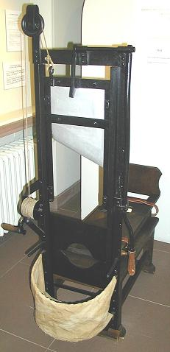

Slide 31
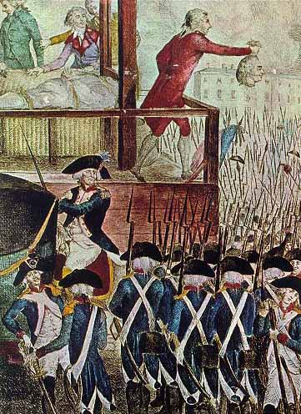

Slide 32
Execution of Louis XVI
The Mountain wins the debate
Louis executed 21 January 1794
First Coalition and others in France react
  First Coalition=Austria, Prussia, Spain, Portugal, Britain, the Dutch Republic, and Russia

Slide 33
Whole ranges of houses, always the most handsome, burnt. The churches, convents, and all the dwellings of the former patricians were in ruins. When I came to the guillotine, the blood of those who had been executed a few hours beforehand were still running in the street…I said to a group of sans-cullottes that it would be decent to clear away all of this human blood. “Why should it be cleared?”, one of them said to me. “It’s the blood of aristocrats and rebels. The dogs should lick it up.”
      German witness to the Terror in Lyon, 1793

Slide 34
Committee of Public Safety
& The Terror
Committee of Public Safety takes control – Approve Reign of Terror
  Danton
  Robespierre
  Marat
Reign of Terror
  Revolutionary Courts
  Victims: Royalists, noble birth, clergy, accused conspirators, peasants & bourgeois who say something against revolution
  250,000 arrested; 17,000 tried & executed; 12,000 executed w/o trial; thousands die in jail, including Louis XVII
  Lyon (1,800 killed), Vendée (100,000 killed)

Slide 35
The Republic of Virtue
Free compulsory education for boys and girls
Established public welfare for poor
Imposed price controls on bread
Abolish workers’ associations, unions
Abolish titles: Everyone is “Citizen”
Establish new calendar
Replace Christianity with a “Cult of Reason”
Confiscate Church and noble lands, distribute to poor
Replace royal measurements with metric system

Slide 36
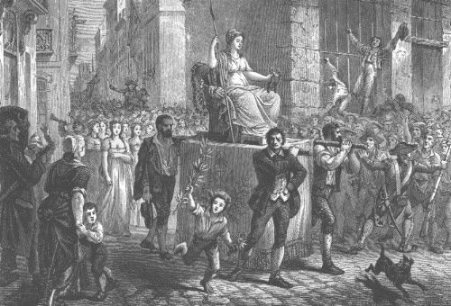

Slide 37
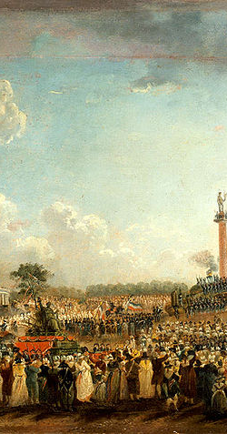
Cult of the Supreme Being
Robespierre’s quasi-religious folly – existence of a god and the immortality of the soul were its two main tenants
It was intended to replace Catholicism while not being completely atheistic – it was a more “rational deism”
These beliefs were a “constant reminder of justice” and an echo of the civic minded public virtue of the Greeks and Romans

Slide 38
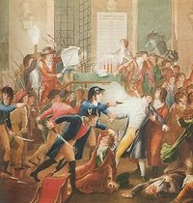
Death of Robespierre
Robespierre out of control
Thermidorian Reaction – coup against the Committee’s founders & the Jacobin Club
National Convention executes Robespierre, 28 July 1794
Terror winds down

Slide 39
The Directory
Committee of Public Safety weakened
New constitution
  Franchise reduced to 30,000 landowners
The Directory formed
  Five man board of directors selected by legislature
  Rules with legislature
  Weak, ineffective
  Consistently unpopular
  Corrupt
  High taxes
  High prices
Allied coalition breaks up in 1795
  Only Britain and Austria remain
  France annexes Austrian-Netherlands
  By 1796-1797, enters Italy
People tired of Directory
French long for strong ruler
1799 Napoleon overthrows Directory

Slide 40
Summary of Revolutionary Government Structures
Estates General (May 1789)
Communes (12 June 1789)
National Assembly (17 June 1789)
National Constituent Assembly (19 June – 30 September 1791)
Legislative Assembly (1 October 1791-11 July 1792)
Paris Commune (end of Leg. Assembly)
Provisional Executive Committee (Aug-Sept 1792)
(National )Convention (20 September 1792 – 21 August 1795)
  Committee of Public Safety
  Committee of General Security
  Revolutionary Tribunal
The Directory (December 1799-May 1804)

